Slide 1
AI-enabled Intelligent Assistant to Improve Reading and Comprehension Skills in English Language
24-25J-027
Notes:
Welcome to the proposal presentation of our research project, "AI-enabled Intelligent Assistant to Improve Reading and Comprehension Skills in English Language

Slide 2

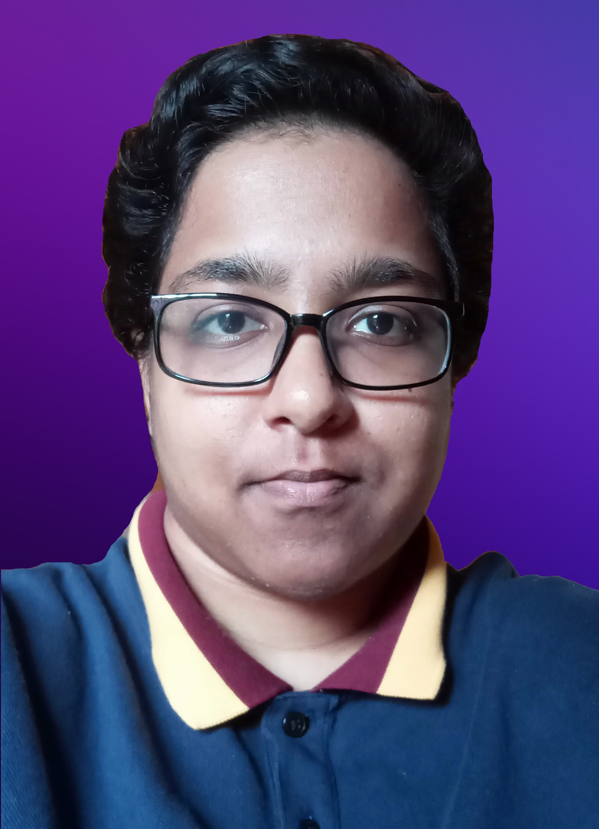



Our Team
Ranaweera A.P.
IT21182396
Kumarathunga S. A. D. S.
IT21182396
Sooriyaarachchi M.D.A.
IT21173790
Senanayake W.G.B.
IT21158322
5/26/2025
2
Notes:
This is our team

Slide 3


Introduction
AI-enabled system which can offer personalized content and activities based on skill level & interests of the user to enhance English reading and comprehension skills.
5/26/2025
3
Notes:
Our goal is to develop an AI-driven system that personalizes content and activities based on the user's skill level and interests
This system will help users to improve their English reading and comprehension abilities.
By leveraging cutting-edge AI technologies, we aim to create a dynamic, engaging, and effective learning experience tailored to each individual's needs.

Slide 4
Research Problem
Proficiency in English required for higher education & professionalism.
Reading & comprehension skills vital for academic success & critical thinking.
Current educational tools do not adequately address the needs of English learners in terms of comprehension.
Challenges:
Lack of dynamic content tailored to user’s skill level and interest
Inability to provide feedback
Lack of tools that can evaluate essay-type questions without human involvement.
5/26/2025
4
Notes:
Proficiency in English is essential for higher education and professional success.
Strong reading and comprehension skills are the foundation for academic achievement and critical thinking.
However, current educational tools often fall short in meeting the needs of English learners, particularly in comprehension.
They lack dynamic content tailored to individual skill levels and interests, fail to provide personalized feedback, and do not offer tools capable of evaluating essay-type questions without human intervention.
Addressing these challenges is crucial for empowering learners and enhancing their English proficiency.

Slide 5
Research Objectives
Main Objective: Provide a AI-enabled platform to improve reading and comprehension skills in English language.
Sub Objectives:
Provide a gamified platform to improve English vocabulary.
Provide a platform to improve basic comprehension skills such as Keywording, Skim reading, Scanning
Provide a platform to improve advances comprehension skills such as Sequencing, Summarizing, Self-questioning
Identify user errors and provide a list of similar-sounding words for practice. Develop and train a model to achieve accurate phoneme-level detection.
5/26/2025
5

Slide 6
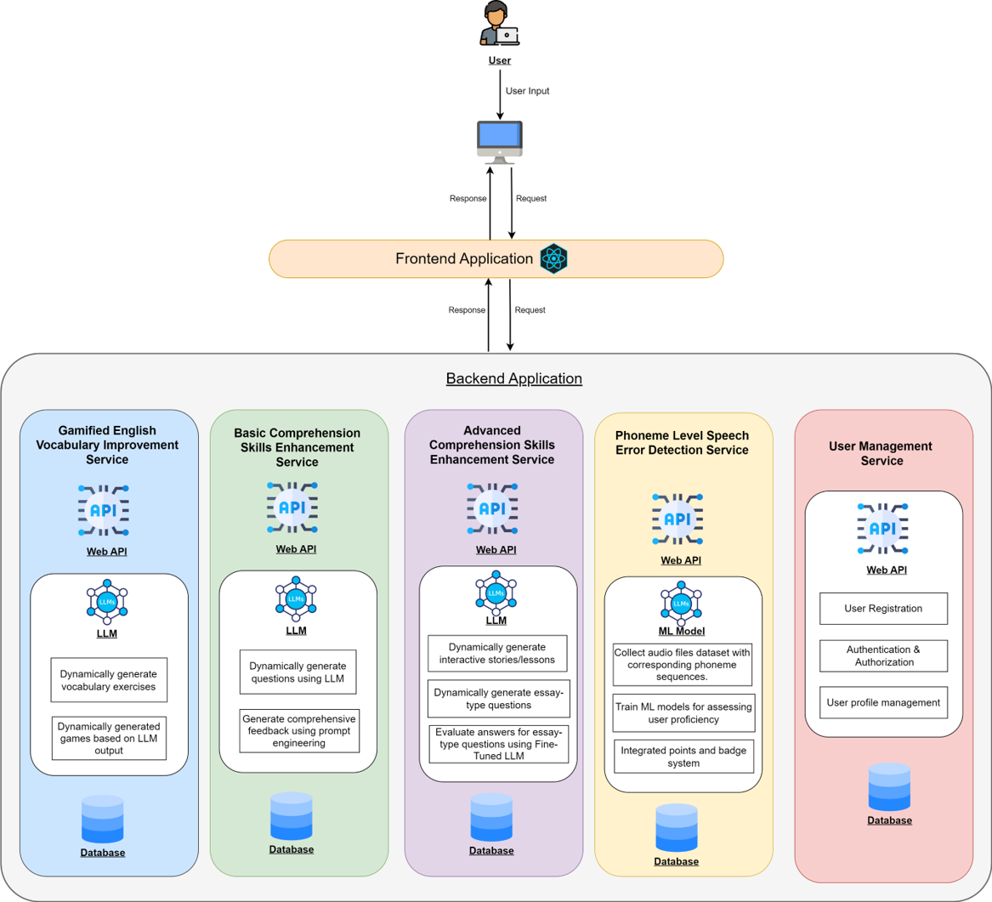
Overall System Diagram
5/26/2025
6
Notes:
This is a high level diagram of our proposed system. We intend use microservice architecture to implement our web application. In next sections you will hear more about these individual services.

Slide 7
AI-Powered Gamified English Vocabulary Improvement Module
IT21173790 – Sooriyaarachchi M.D.A
IT21173790 | Sooriyaarachchi M.D.A | 24-25J-027
5/26/2025
7

Slide 8

Research Problem?
The challenge is to create a system that dynamically generates personalized educational exercises as games, based on a student’s Level and Preferences
How to identify Student Vocabulary Level
How to Generate Personalize Vocabulary Games
IT21173790 | Sooriyaarachchi M.D.A | 24-25J-027
5/26/2025
8

Slide 9



Specific and Sub Objectives
Specific Objective
Provide a platform to improve Vocabulary Skills according to user level and preferences
Identify and analyze student vocabulary needs
Create a RAG system for Generate Personalized and Adaptive Vocabulary Games
Implement Real-Time Feedback and Intelligent Support
IT21173790 | Sooriyaarachchi M.D.A | 24-25J-027
5/26/2025
9

Slide 10
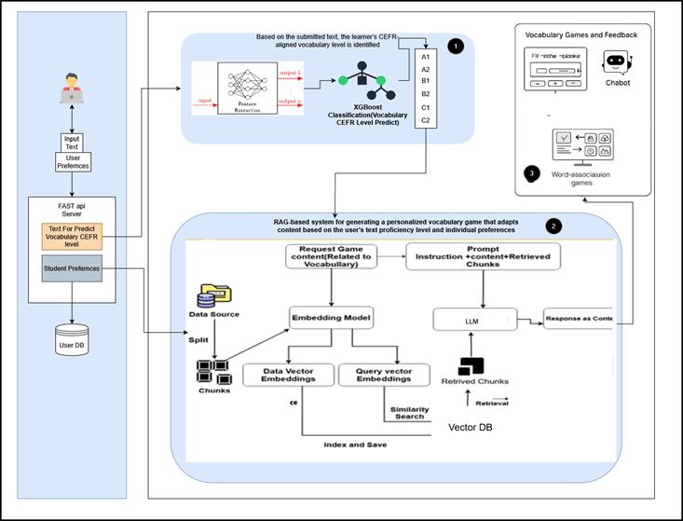
System Diagram
IT21173790 | Sooriyaarachchi M.D.A | 24-25J-027
5/26/2025
10
Notes:
Personalization of Content Generation:
Ensure Accuracy of Word Definitions:
Thease data set convert to chunks
After these chunks convert embedding usinng embedding model in hagging face
After thease numerical values stored in pinecone vector database
When system or user request things .it also convert to embedding and search similarity
After return similar values and this values combined with prompt and system request and input to llm
There 3 types of challenge games
One is word association challenge
select Which word shares a similar meaning or context given word
guess the word according to given hint and check word spellings
word describing game ,the player describe the word with out using word and related word

Slide 11
Tools & Technologies
Frontend - React js & Tailwind Css
Backend – Python ,FastAPI
Database – MongoDB, Pincone DB
Data Embedding Model-Hugging Face Transformer model
Lang Chain Frameworks
Text Preprocessing and Feature Extraction-NLP Model
Model Trained Algorithm-Xgboost
Deployment- Github actions,AWS Ecs,Docker
IT21182396 | A. P. Ranaweera | 24-25J-027
5/26/2025
11

Slide 12
Software Specification Requirements
Functional:
The system should be able to Predict Vocabulary Level according to user given Text Input
The system should be able to dynamically generate vocabulary games given on user’s Preference and vocabulary level
The system should be able to give personalize feedback about user's answer and Definition of the word
Non Functional: Accuracy , Performance, Availability, Usability
IT21173790 | M.D.A Sooriyaarachchi | 24-25J-027
5/26/2025
12

Slide 13
Other Requirements
Software:
React Js
Python and Fast Api
MongoDB and Pinecone DB
AI/ML: Llama, Mistral AI, Langchain
CI/CD – GitHub, Docker, Kubernetes
Personal:
Expertise in RAG architecture
Expertise in ML related
Expertise in Database Design
Expertise in System Design & Deployment
IT21182396 | A. P. Ranaweera | 24-25J-027
5/26/2025
13

Slide 14
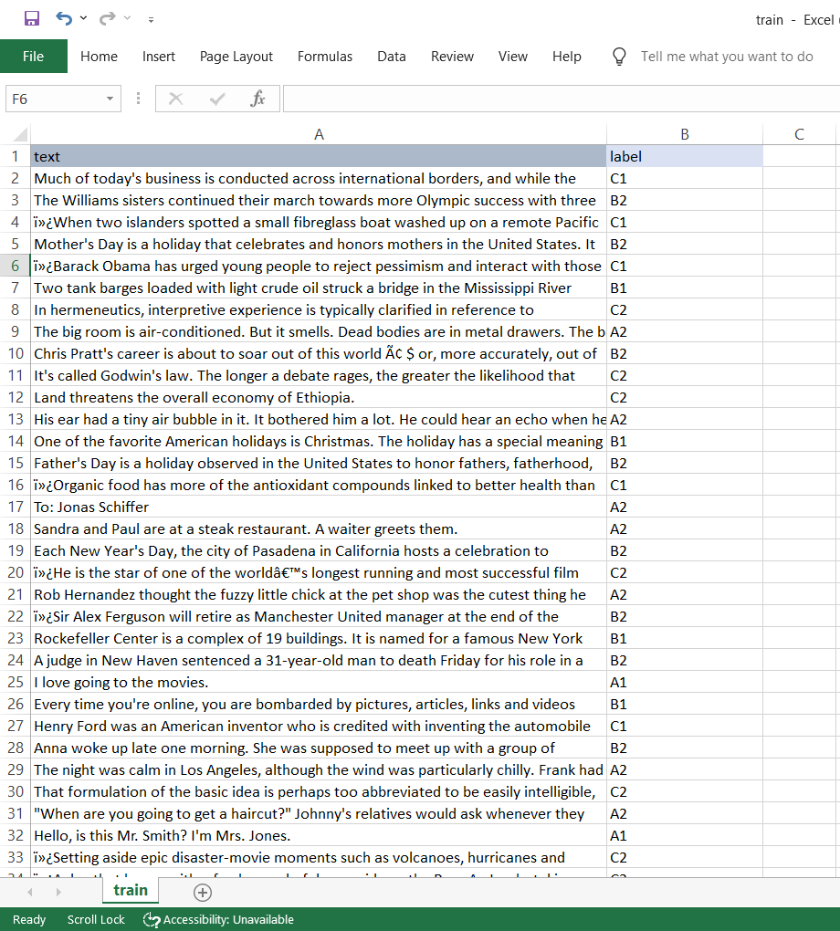
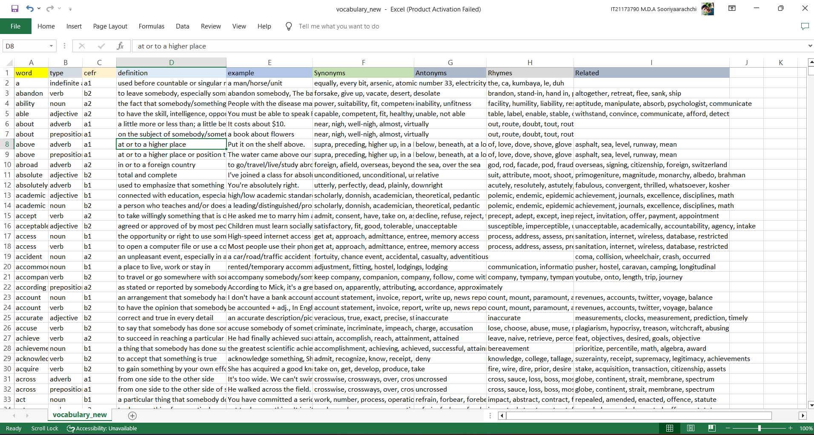
•Sub-Objective - 1.
Data Collection
ML model Trained Data Set
RAG System Implementation
IT21173790 | Sooriyaarachchi M.D.A | 24-25J-027
5/26/2025
14
Notes:
I prepared data collection as a around 7000 word with definitions with examples

Slide 15
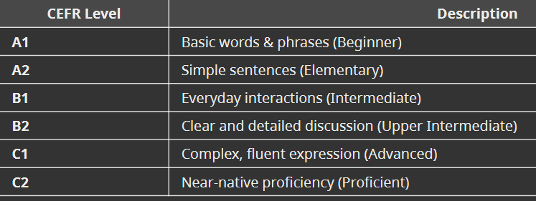
Dataset Overview
Continue training the model for enhanced accuracy.
Expand and im•Sub-Objective - 1.
prove the dataset.
Integrate accurate pre-trained models for phoneme error detection.
Each dataset contains texts written by students at different CEFR levels.
Used to train a machine learning model to predict a student's given text vocabulary level.
IT21182396 | A. P. Ranaweera | 24-25J-027
5/26/2025
15
Notes:
The Common European Framework of Reference for Languages (CEFR) categorizes language
proficiency into six levels: A1, A2, B1, B2, C1, C2

Slide 16
Data Preprocessing &Feature Engineering
Sub-Objective - 1.
Data Preprocessing & Feature Engineering
Converts raw text into numerical features This helps the model understand the text and improve performance by capturing patterns related to, grammar, and vocabulary richness.
Key Features Extracted:
✅ POS Tag Ratios (Noun, Verb, Adjective distribution)
✅ Sentence Complexity (Parse Tree Depth)
✅ Named Entities Count (Proper nouns, locations, etc.)
Used NLP (`small-sized English language model provided by spaCy)
IT21182396 | A. P. Ranaweera | 24-25J-027
5/26/2025
16
Notes:
Feature engineering is the process of picking and creating important features from raw data to help improve the model's performance
For that process I used Used NLP (`small-sized English language model provided by spaCy)

Slide 17
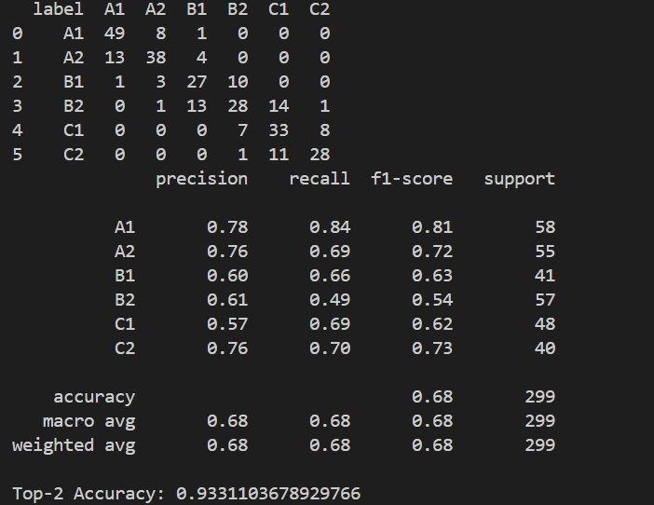
Model Training & Evaluation
Prepare the data for the RNN model.
Design the model architecture using an RNN (LSTM or GRU layers).
Sub-Objective - 1.
ed audio features (MFCCs) and phoneme mappings.
Evaluate the model'sperformance.
Continue training the model for enhanced accuracy.
Expand and improve the dataset.
Integrate accurate pre-trained models for phoneme error detection.
Xgboost algorithm used for Trained Model
Trained on feature-engineered CEFR text data
Evaluate with Accuracy, Confusion Matrix, Precision-Recall Curve
IT21182396 | A. P. Ranaweera | 24-25J-027
5/26/2025
17
Notes:
Main algorithm used for training the CEFR level prediction model, chosen for its high accuracy, scalability, and ability to handle complex patterns in text data.
The model was trained using preprocessed and feature-engineered text data derived from CEFR levels, focusing on key features like word frequencies, n-grams, and semantic patterns.

Slide 18
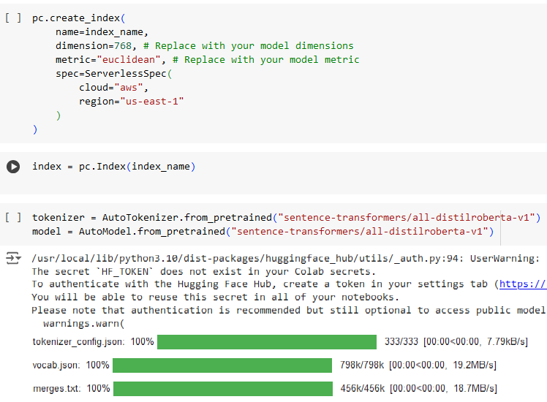
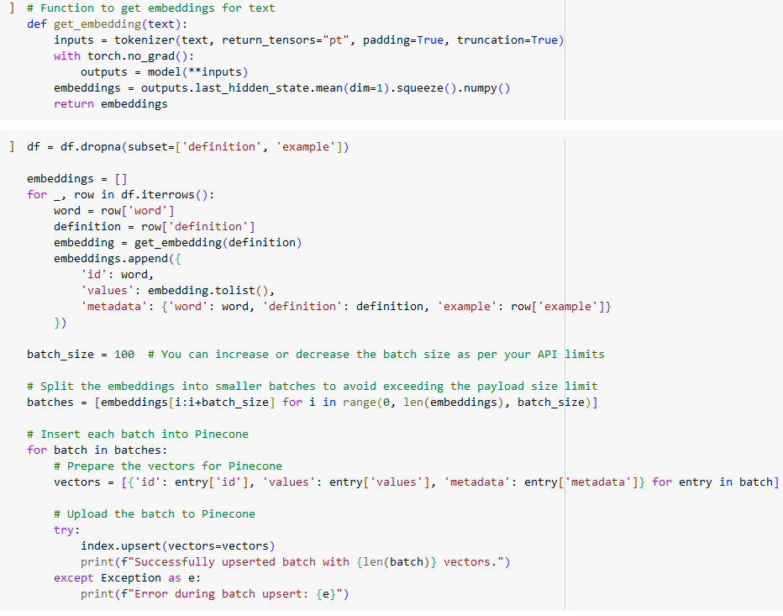
•Sub-Objective - 1,2 RAG Implementation Work Flow Embedding ​Creation
IT21173790 | Sooriyaarachchi M.D.A | 24-25J-027
5/26/2025
18
Notes:
This is RAG implementation for personalized vocabulary game content generate according to Level and preferences

Slide 19
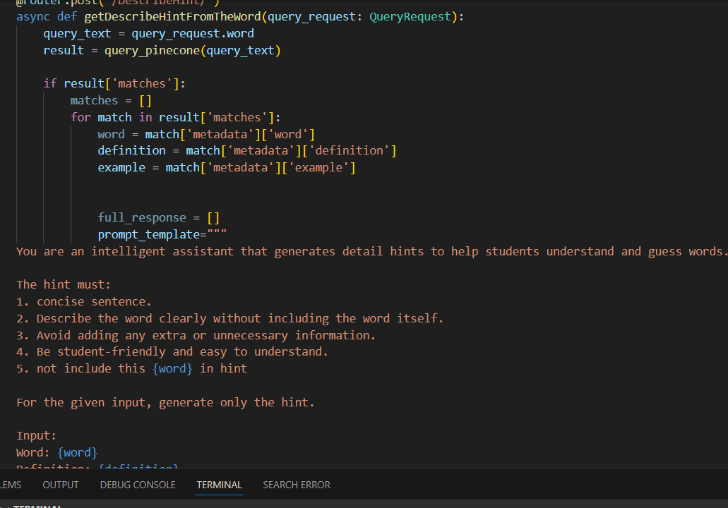
RAG Implementation Work Flow RAG system Integrate with Fast API
IT21173790 | Sooriyaarachchi M.D.A | 24-25J-027
5/26/2025
19

Slide 20
Summary of Achievement(100%)
Prepared the dataset (Vocabulary List and CREF Level Student Writing Text Dataset).
Trained the model to predict levels and deployed it.
Created a Retrieval-Augmented Generation (RAG) system for personalized gaming content retrieval based on user level and preferences.
Completed FastAPI backend.
Implemented the frontend UI and integrated it with the backend.
Deploy Service in AWS ecs
IT21182396 | A. P. Ranaweera | 24-25J-027
5/26/2025
20

Slide 21
References
[1] P. Dillenbourg, M. Jermann, and S. Gurtner, "Introduction to dual and interactive learning," New Learning Models, vol. 5, no. 3, pp. 45-55, 2006.
[2] T. B. Brown et al., "Language Models are Few-Shot Learners," arXiv preprint arXiv:2005.14165, 2020.
[3] A. K. Dey and G. D. Abowd, "Towards a Better Understanding of Context and Context-Awareness," Proc. HUC '99, 1999, pp. 304-307.
[4] N. G. Nagy, P. W. Herman, and R. C. Anderson, "Learning Words From Context," Reading Research Quarterly, vol. 20, no. 2, pp. 233-253, 1985.
21
5/26/2025
IT21173790 | Sooriyaarachchi M.D.A | 24-25J-027
5/26/2025
21

Slide 22
Demo
IT21173790 | Sooriyaarachchi M.D.A | 24-25J-027
5/26/2025
22

Slide 23
Basic Comprehension Skills Module
IT21158322 – W. G. B. Senanayake
IT21158322 | W. G. B. Senanayake | 24-25J-027
5/26/2025
23

Slide 24
Research Problem?
How can we leverage AI technologies, Large Language Models (LLMs) to dynamically generate quizzes and reading paragraphs
IT21158322 | W. G. B. Senanayake | 24-25J-027
5/26/2025
24

Slide 25
Research Objectives
Main Objective:
Integrate AI-based technologies to generate dynamic quizzes
Sub Objectives:
Develop a system that generates basic level quizzes (MCQ).
Dynamically generate reading paragraphs tailored to different comprehension levels.
IT21158322 | W. G. B. Senanayake | 24-25J-027
5/26/2025
25

Slide 26
Tools & Technologies
T5-Small (Text-to-Text Transfer Transformer) is a transformer-based language model developed by Google Research as part of the T5 (Text-To-Text Transfer Transformer) family. It is designed to handle a variety of natural language processing (NLP) tasks by converting all tasks into a text-to-text format (60 million parameters)
Dataset- Cefr model dataset using Keggle and my own dataset
IT21158322 | W. G. B. Senanayake | 24-25J-027
5/26/2025
26

Slide 27
T5 Small Model
Why T5?: T5 is highly versatile and can be used for tasks like translation, summarization, question answering, and text generation. Its text-to-text framework makes it easy to adapt to new tasks by simply formatting the input and output as text.
How it works: The input is a text prompt (e.g., "Generate a paragraph and MCQ for Level B1 and Topic fairy tales"). The model generates the output as text (e.g., "Paragraph: Once upon a time... MCQ: Question: What did the princess lose? Options: [A ring, A shoe, A crown] Answer: A shoe")
Train Using Supervised Learning Method
IT21158322 | W. G. B. Senanayake | 24-25J-027
5/26/2025
27

Slide 28
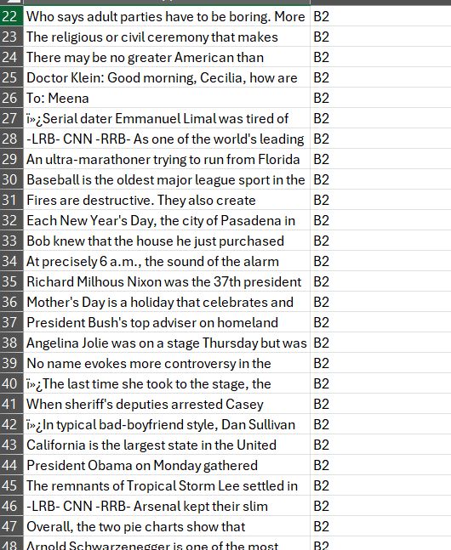
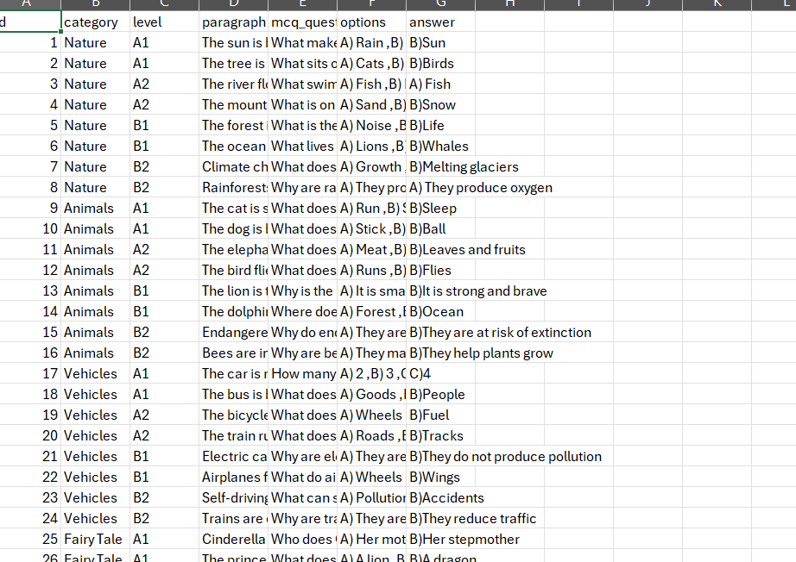
•Sub-Objective - 1.
Data Collection
Mcq Questions
Kaggle
IT21173790 | Sooriyaarachchi M.D.A | 24-25J-027
5/26/2025
28
Notes:
I prepared data collection as a around 7000 word with definitions with examples

Slide 29
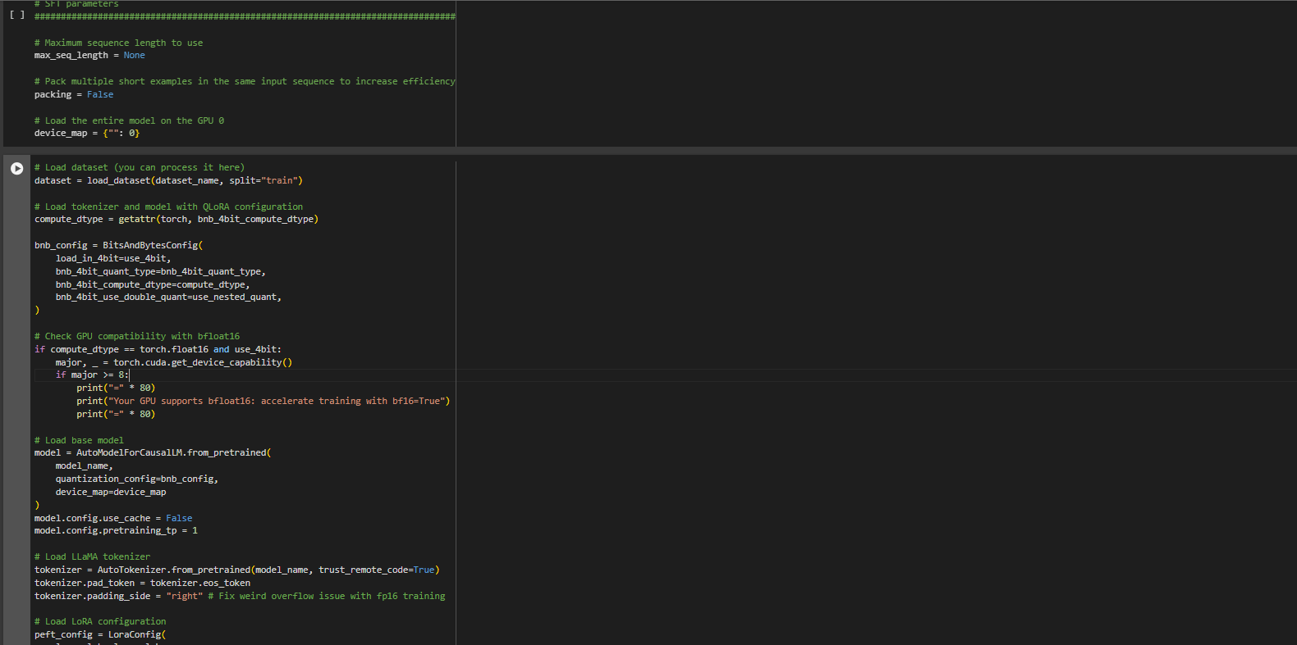
Implementation
Fine tune T5 model using Google Colab NoteBook

Slide 30
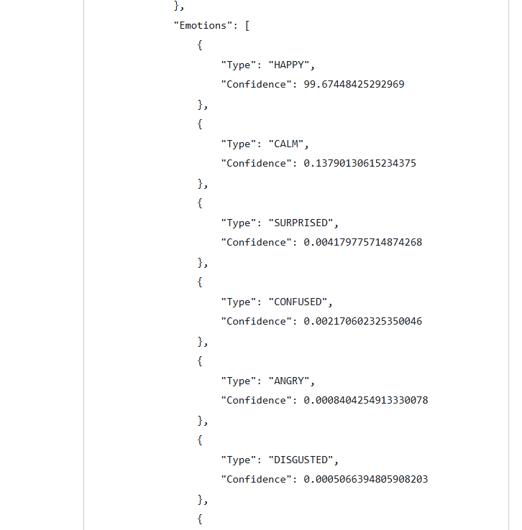
Personalize Path
Amazon Rekognition Custom Labels
Identify User Interaction and their Emotion During the Quiz
Change preferences based on user mode
IT21158322 | W. G. B. Senanayake | 24-25J-027
5/26/2025
30

Slide 31
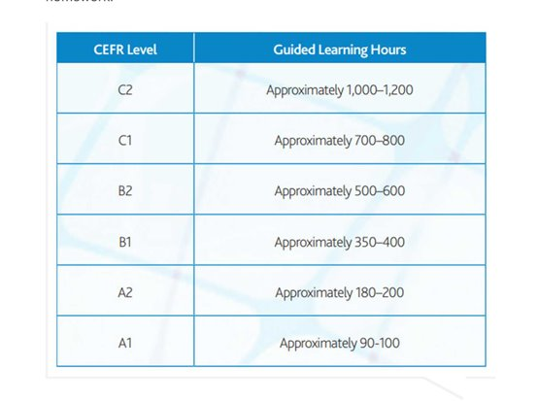
Personalize Path
Base Score Calculation:
It combines accuracy of answers and timing efficiency. Accuracy is calculated based on correct answers,
and timing efficiency adjusts the score based on how quickly or slowly the responses were given compared to expected times for the CEFR (Common European Framework of Reference for Languages) levels.
IT21158322 | W. G. B. Senanayake | 24-25J-027
5/26/2025
31

Slide 32
Personalize Path
LLM Adjustment: It sends the gathered data to a LLM to receive contextual adjustments based on the learning round's characteristics.
This adjustment influences the final score based on the returned adjustment and reason.
IT21158322 | W. G. B. Senanayake | 24-25J-027
5/26/2025
32

Slide 33
Tools & Technologies
Frontend - JavaScript & React
Backend - Python & Fast APi
AWS Lambda
Database - Firebase
CI/CD – GitHub, Docker, Fargate and ECScontent.
Large Language Models- T5 Small
Prompt Engineering for refining AI-generated content.
IT21158322 | W. G. B. Senanayake | 24-25J-027
5/26/2025
33

Slide 34
Advanced Comprehension Skills Enhancement Module
IT21118340 – S. A. D. S. Kumarathunga
IT21118340 | S. A. D. S. Kumarathunga | 24-25J-027
5/26/2025
34
Notes:
Hi everyone, My name is S. A. D. S. Kumarathunga. I’m responsible for ..

Slide 35


Background
What are Advanced Comprehension Skills?
Understanding the implied meaning of the text.
Ability to evaluate and analyze given text.
Skills:
Making inferences and deductions,
Connecting different parts of the text
Applying background knowledge
Finding the main idea, important facts, and supporting details
Summarizing
Generating and Asking Questions
IT21118340 | S. A. D. S. Kumarathunga | 24-25J-027
5/26/2025
35
Notes:
What exactly are advanced comprehension skills?
They go beyond simply understanding the words on a page.
Advanced comprehension involves grasping the implied meaning of a text, evaluating and analyzing the content, and applying critical thinking.
These skills include making inferences and deductions, connecting different parts of the text, applying background knowledge, identifying the main idea, important facts, and supporting details, summarizing, and generating as well as asking insightful questions.
Developing these skills is essential for deep, meaningful engagement with any text.

Slide 36

Research Problem?
Lack of Tools for Generating Personalized Content Based on User Interest and Skill Level.
Lack tools to provide assessments for essay-type questions that typically require human evaluation.
IT21118340 | S. A. D. S. Kumarathunga | 24-25J-027
5/26/2025
36
Notes:
One challenge in English education today is the lack of dynamically adaptable content that can adjust to the varying needs of learners.
Also, another significant challenge is that, there are no tools capable of evaluating answers for essay-type questions.
Which means students have to wait for their English teacher to evaluate their work and provide feedback, which is time consuming process
Our proposed system intend to address these gaps and create more time-effective and personalized learning experiences.

Slide 37

Research Gap
Apps | Dynamic Content | Evaluate answers without human involvement | Provide feedback without human involvement
Generic Reading Apps
Duolingo |  | Only offer MCQ based questions | Limited feedback
AceReader Pro
ReadyRead
Smart AI Reading Assistant for Reading Comprehension
Proposed System
IT21118340 | S. A. D. S. Kumarathunga | 24-25J-027
5/26/2025
37
Notes:
This is a table of exiting tools.
As u can see most of them do not offer personalized content,
Answer evaluation nor comprehensive feedback.

Slide 38
Research Objectives
Main Objective: Provide a platform to improve advanced comprehension skills such as Sequencing, Summarizing, Self-questioning
Sub Objectives:
Implement Agentic Workflow for Question Generation based on user interest and skill level
Implement Agentic workflow to accurately evaluate answers and provide feedback without human involvement
Develop the most suitable prompts to generate dynamic exercises, evaluate answers and provide feedback.
IT21118340 | S. A. D. S. Kumarathunga | 24-25J-027
5/26/2025
38
Notes:
The main objective of my research is to provide a platform that enhances advanced comprehension skills, such as sequencing, summarizing, and self-questioning.
To achieve this, I have set several key sub-objectives:
fine-tuning a large language model to generate dynamic content,
refining the model to accurately evaluate answers without human involvement,
and developing the most effective prompts to ensure both content generation and answer evaluation

Slide 39
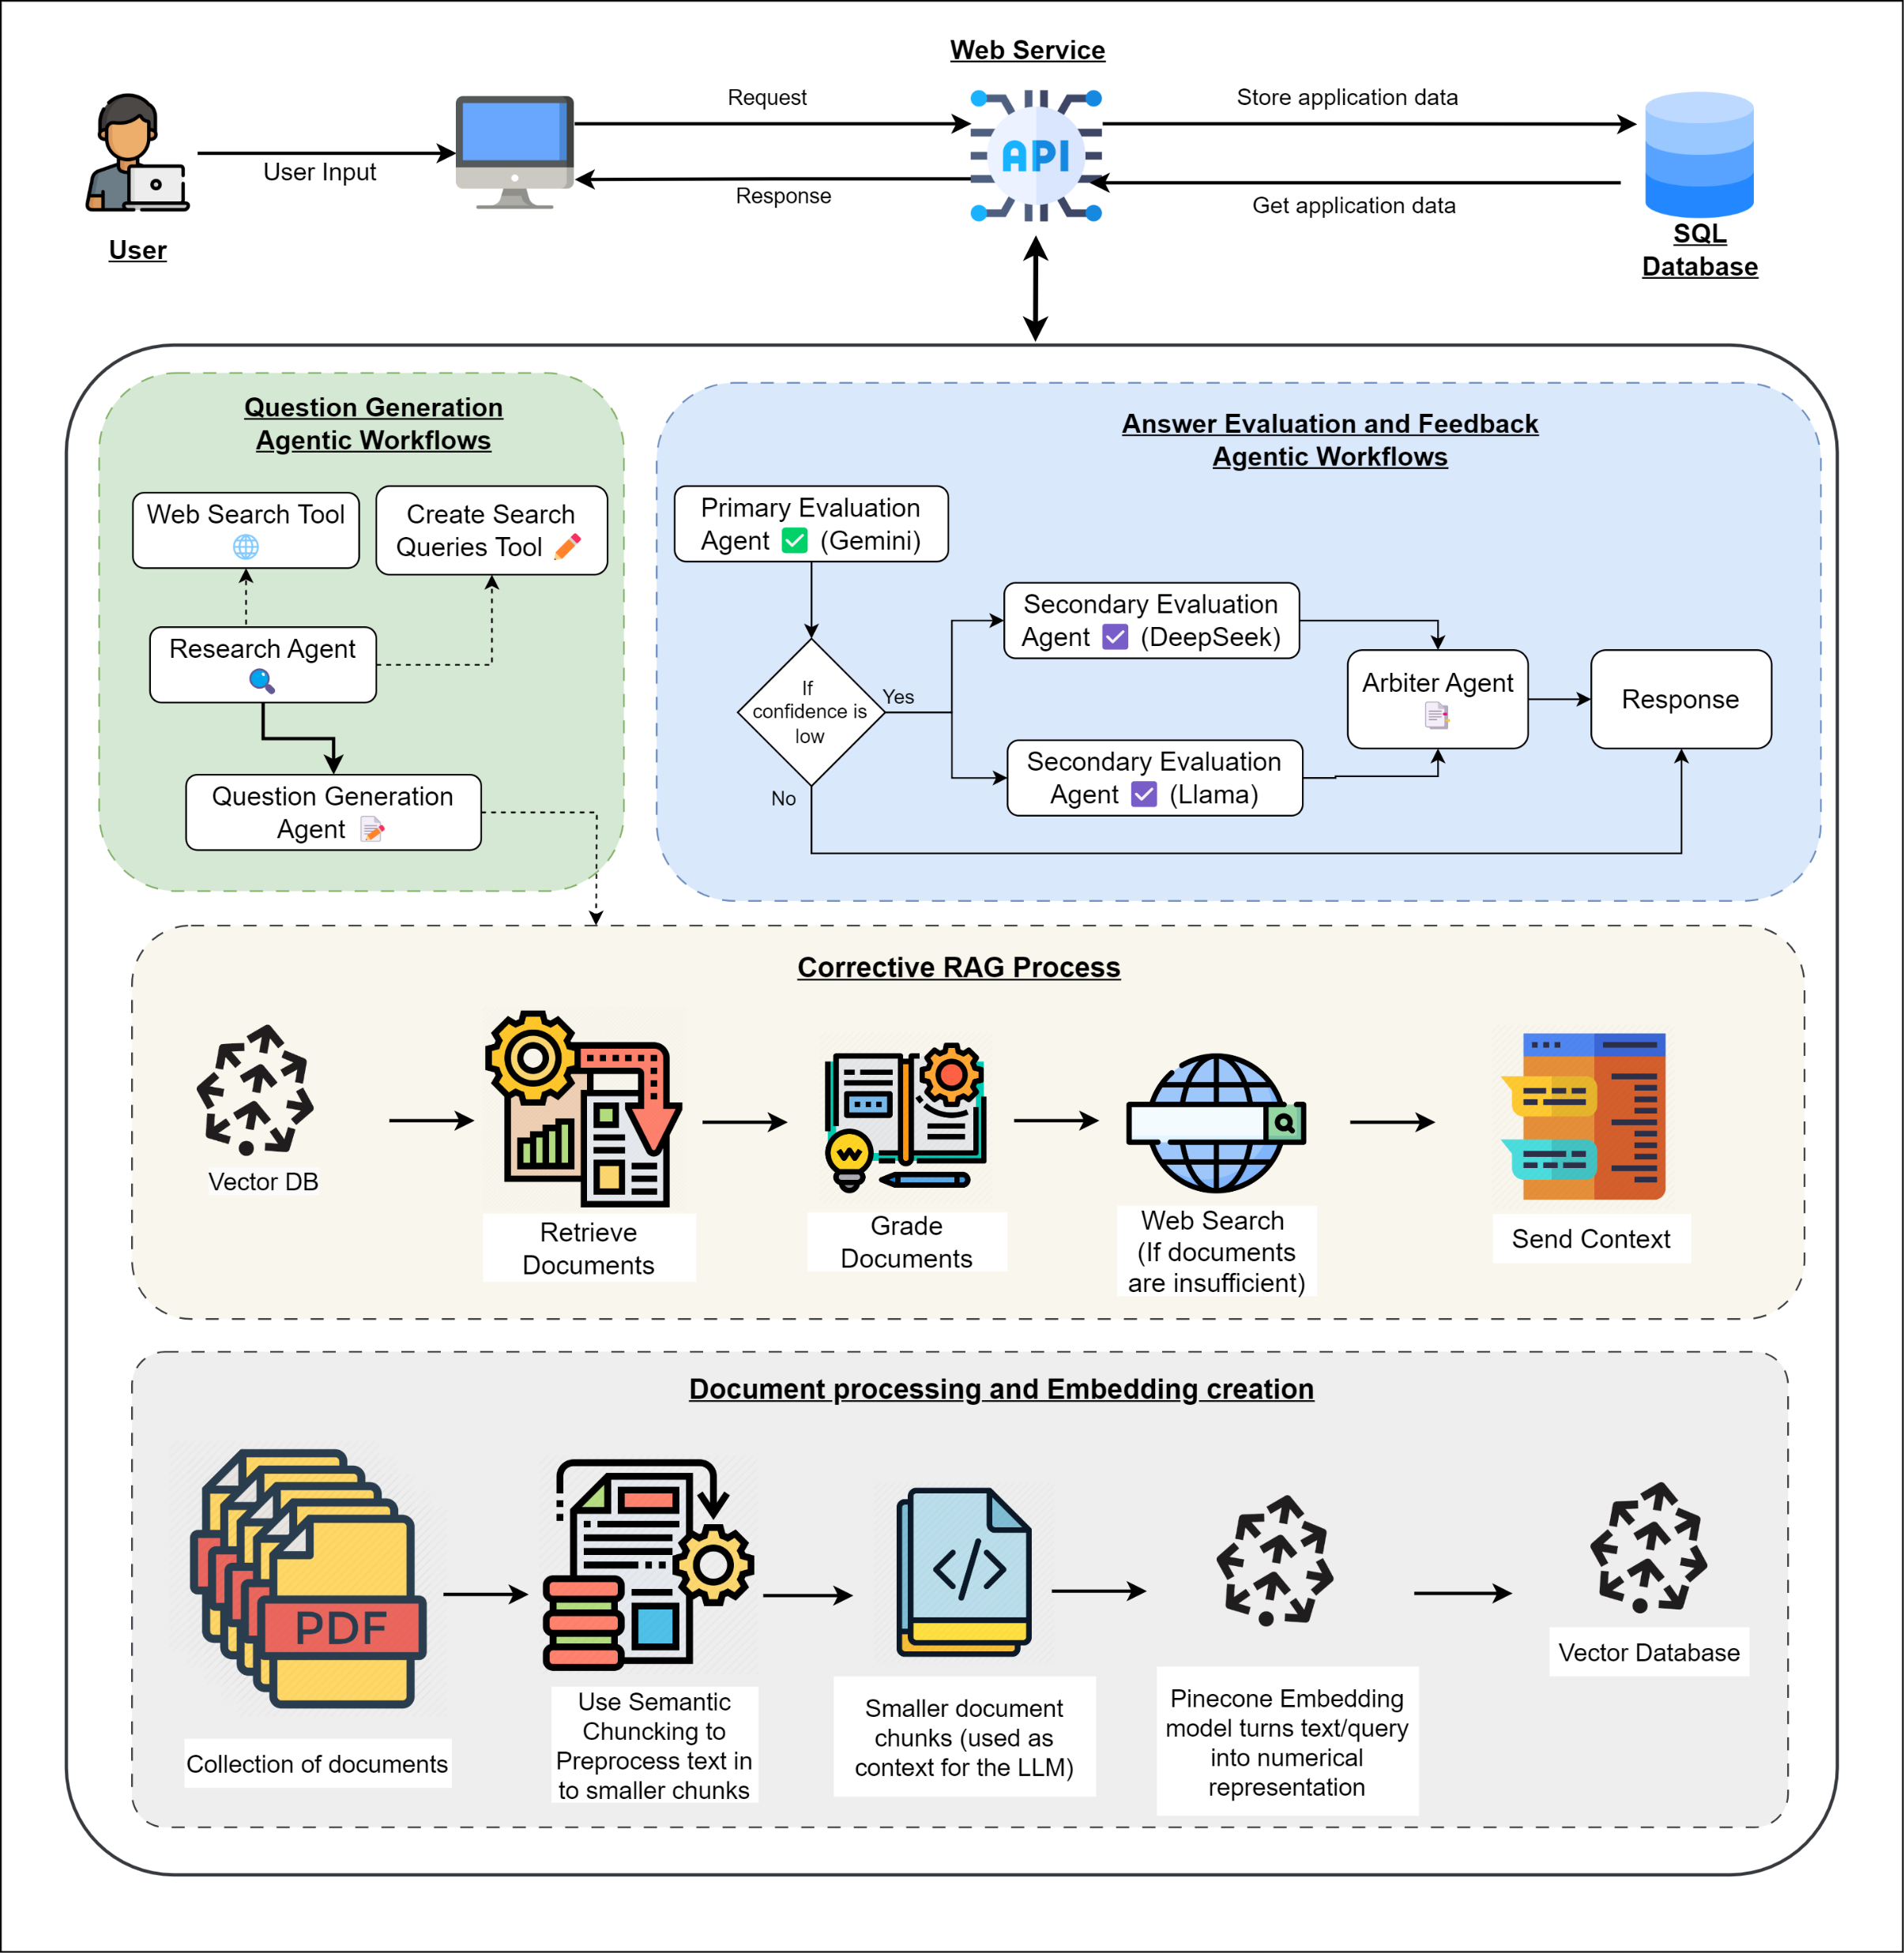
System Diagram
IT21118340 | S. A. D. S. Kumarathunga | 24-25J-027
5/26/2025
39

Slide 40
Tools & Technologies
Frontend – React
Backend – Fast API & Langchain, Llama-Index
Database – Supabase & Pinecone
LLM Model – Gemini, OpenRouter (Deepseek and Meta Llama)
Prompt Engineering Techniques
Zero-Shot Prompting, Few-Shot Prompting, Chain of Thought
RAG Techniques – Corrective RAG
AI Agent – Tool Calling/Tool Use pattern
IT21118340 | S. A. D. S. Kumarathunga | 24-25J-027
5/26/2025
40
Notes:
This is a list of tools and technologies I intent use.
For the frontend, I employ JavaScript and React, while the backend is powered by Python and Django.
Data is managed using Postgres SQL,
Fine-tuned Llama LLM model combined with prompt engineering is used for advanced language processing.
Fine-tuning process is conducted using Vertex AI
Web Hosting is managed on Azure, while models are hosted in Hugging Face

Slide 41
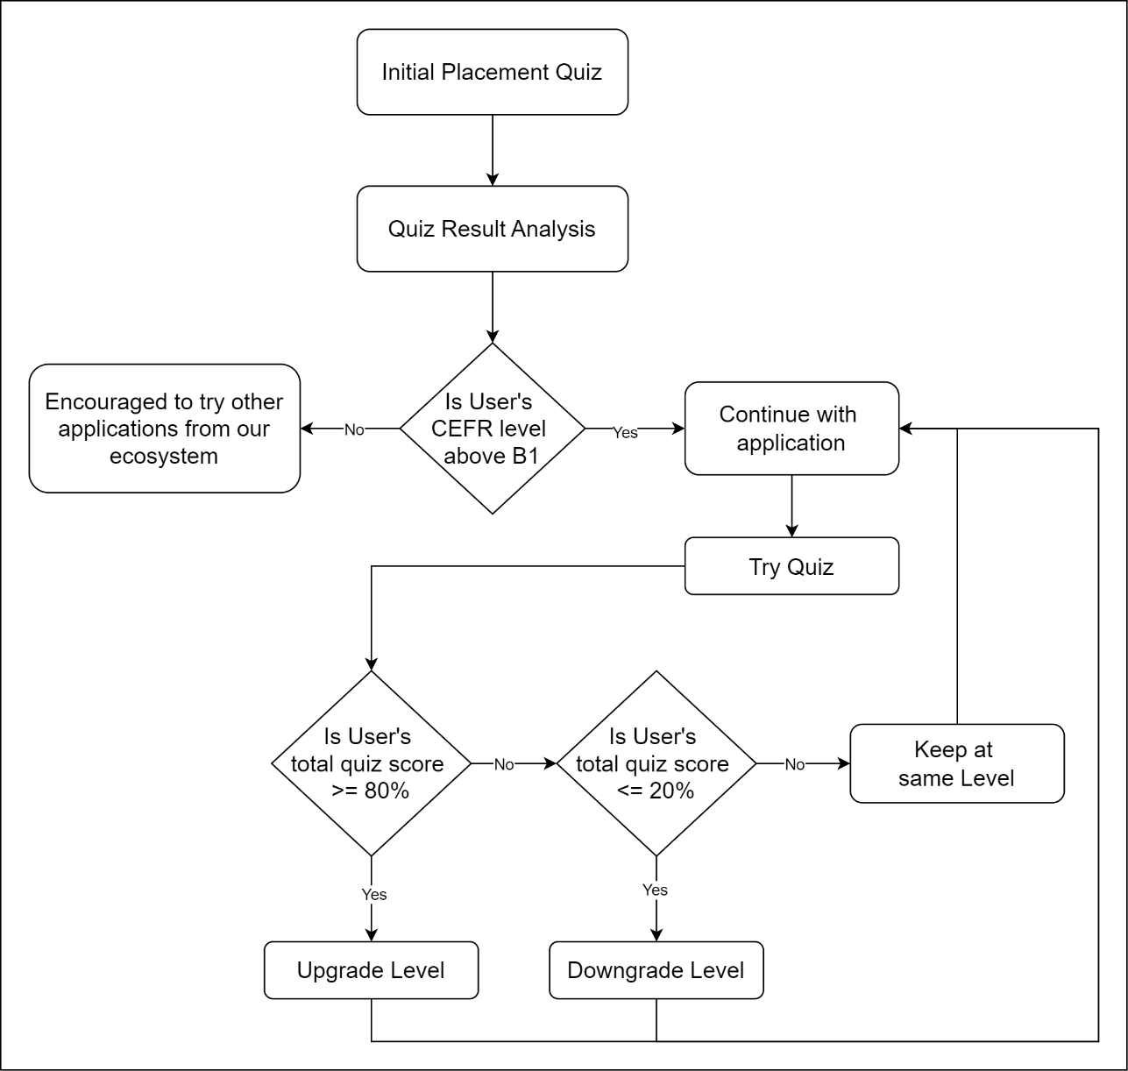
CEFR-Based Level Assessment and Dynamic Progression
The system uses a CEFR-based framework to assess and adapt users’ language proficiency levels.
It starts with a placement quiz focused on B1–C2 levels.
Based on performance, users are guided to suitable modules.
Employs a rule-based system to dynamically change user level ensuring personalized, adaptive learning.
IT21118340 | S. A. D. S. Kumarathunga | 24-25J-027
5/26/2025
41
Notes:
This module uses a CEFR-based framework to assess and adapt users’ language proficiency levels.
A rule-based system that changes skill level based on user performance.

Slide 42
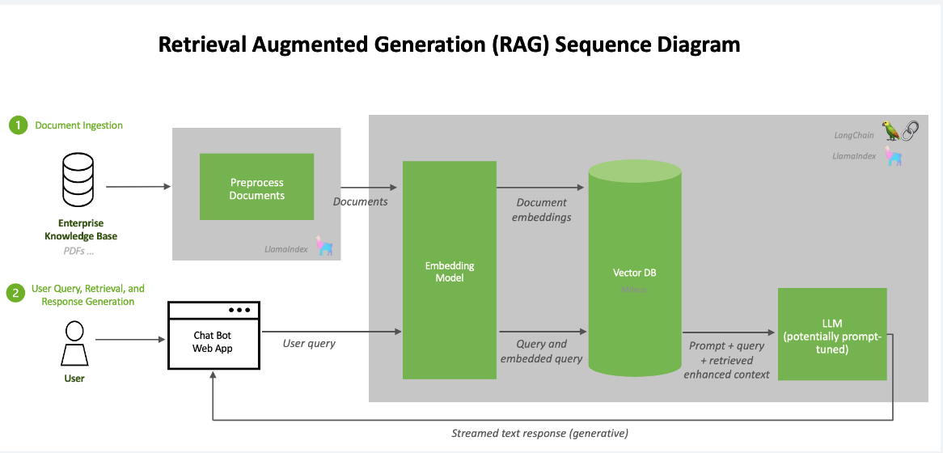
RAG
RAG stands for Retrieval-Augmented Generation. It's an AI technique that combines information retrieval with text generation to produce coherent and contextually relevant outputs. The RAG workflow typically includes embedding creation, and a generation phase..
Embedding : Hugging Face
Open-source platform.
Cost free.
Vector database: Pinecone
Optimized for AI Applications
Semantic Chunking
IT21118340 | S. A. D. S. Kumarathunga | 24-25J-027
5/26/2025
42

Slide 43
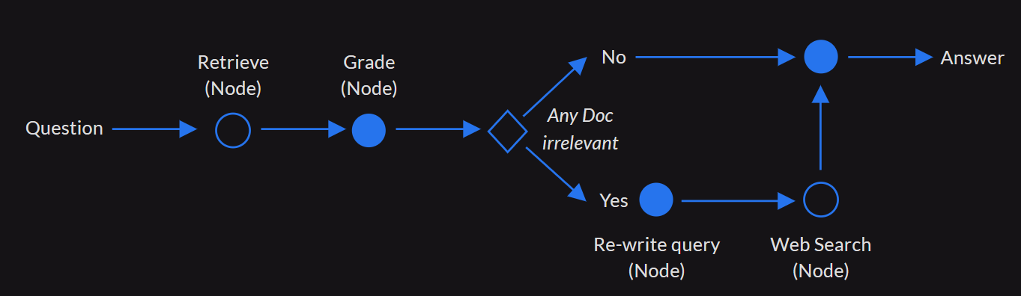
Corrective RAG
IT21118340 | S. A. D. S. Kumarathunga | 24-25J-027
5/26/2025
43
Notes:
Corrective RAG (CRAG) is an enhanced version of traditional RAG that incorporates self-reflection and self-grading mechanisms. It aims to improve the robustness of generation by addressing potential inaccuracies in document retrieval. CRAG includes several key components: a retriever to fetch relevant documents, a retrieval evaluator to assess document relevance, and a corrective processing step to validate and refine retrieved content before generation.

Slide 44
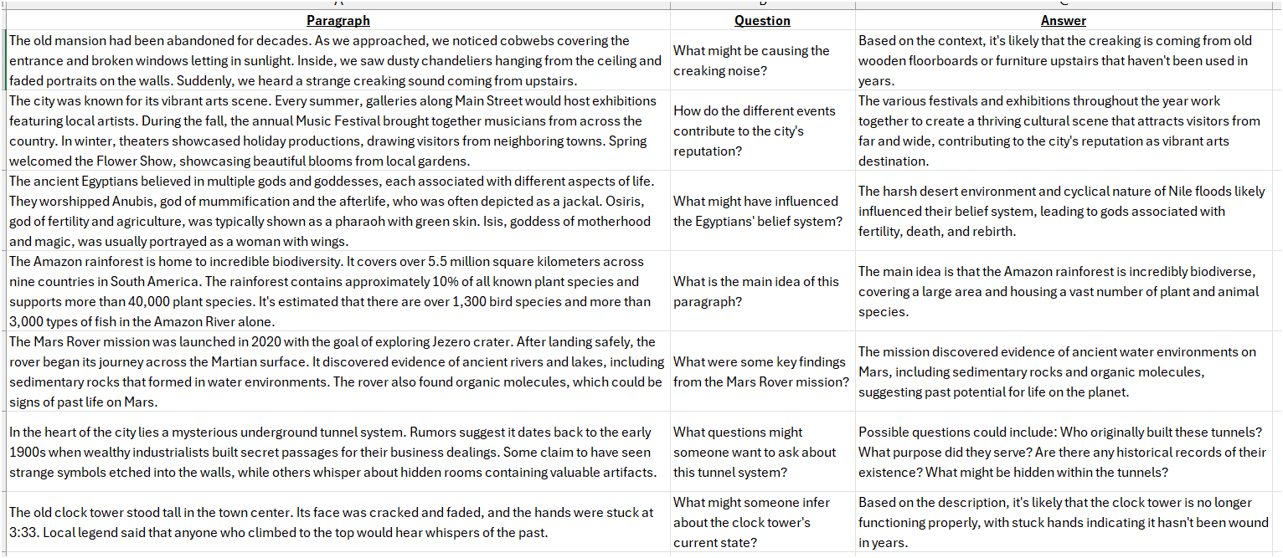
Data Collection
IT21118340 | S. A. D. S. Kumarathunga | 24-25J-027
5/26/2025
44
Notes:
Proposed system is designed with key functional goals in mind.
It will dynamically generate content tailored to the user's interests and skill level,
Accurately evaluate user responses without human intervention,
Provide extensive feedback on their answers.
On the non-functional side, focus is on ensuring accuracy, high performance, availability, and user-friendliness

Slide 45
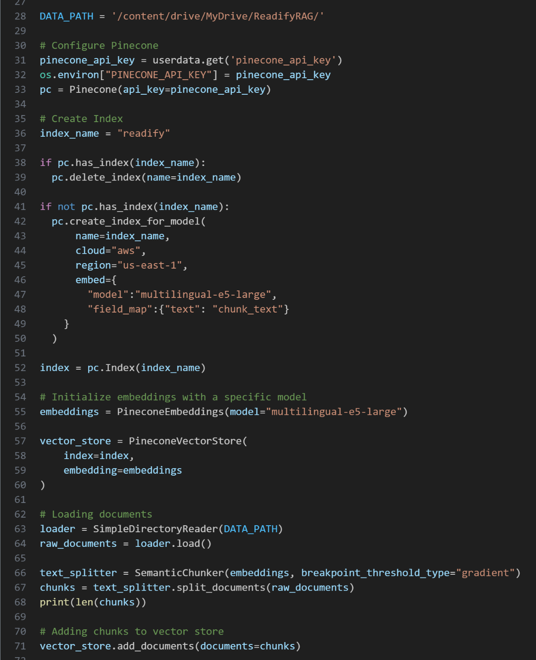
Embedding Creation
Implemented Semantic Chunking using Pinecone
Advanced method that uses embedding model to identify natural break points in the text based on semantic similarity.
IT21118340 | S. A. D. S. Kumarathunga | 24-25J-027
5/26/2025
45
Notes:
Semantic Chunking is an advanced method that uses embedding model to identify natural break points in the text based on semantic similarity,
Creating more coherent and meaningful chunks than fixed size chunk splitting.

Slide 46
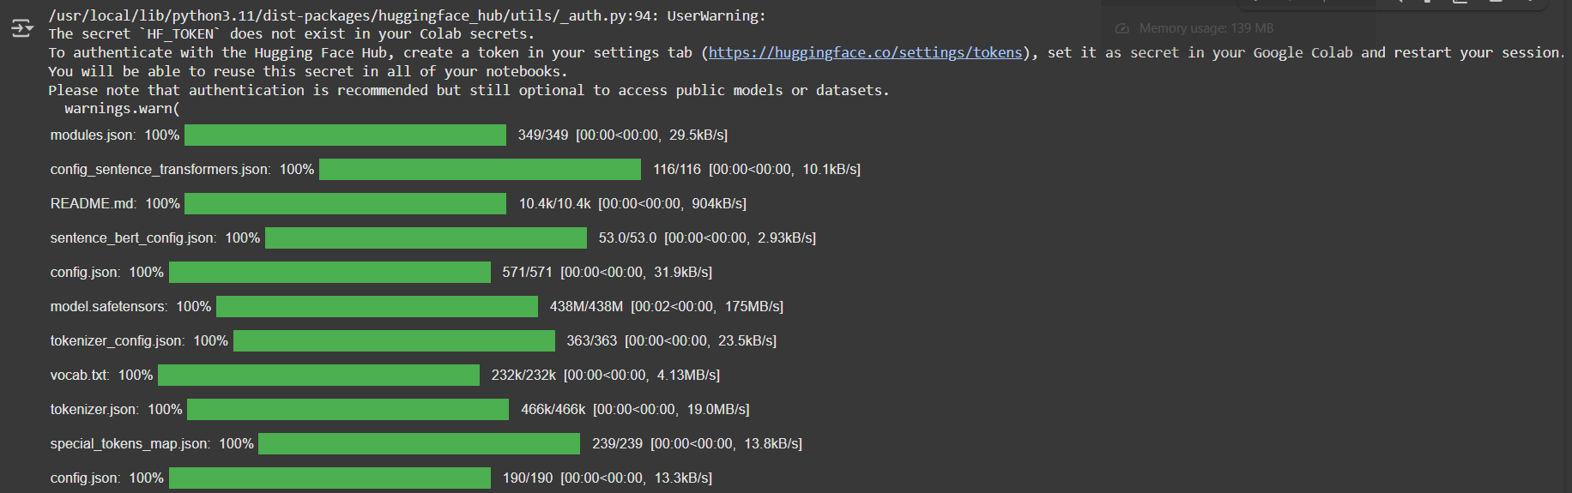
Embedding Creation - Output
IT21118340 | S. A. D. S. Kumarathunga | 24-25J-027
5/26/2025
46
Notes:
Proposed system is designed with key functional goals in mind.
It will dynamically generate content tailored to the user's interests and skill level,
Accurately evaluate user responses without human intervention,
Provide extensive feedback on their answers.
On the non-functional side, focus is on ensuring accuracy, high performance, availability, and user-friendliness

Slide 47
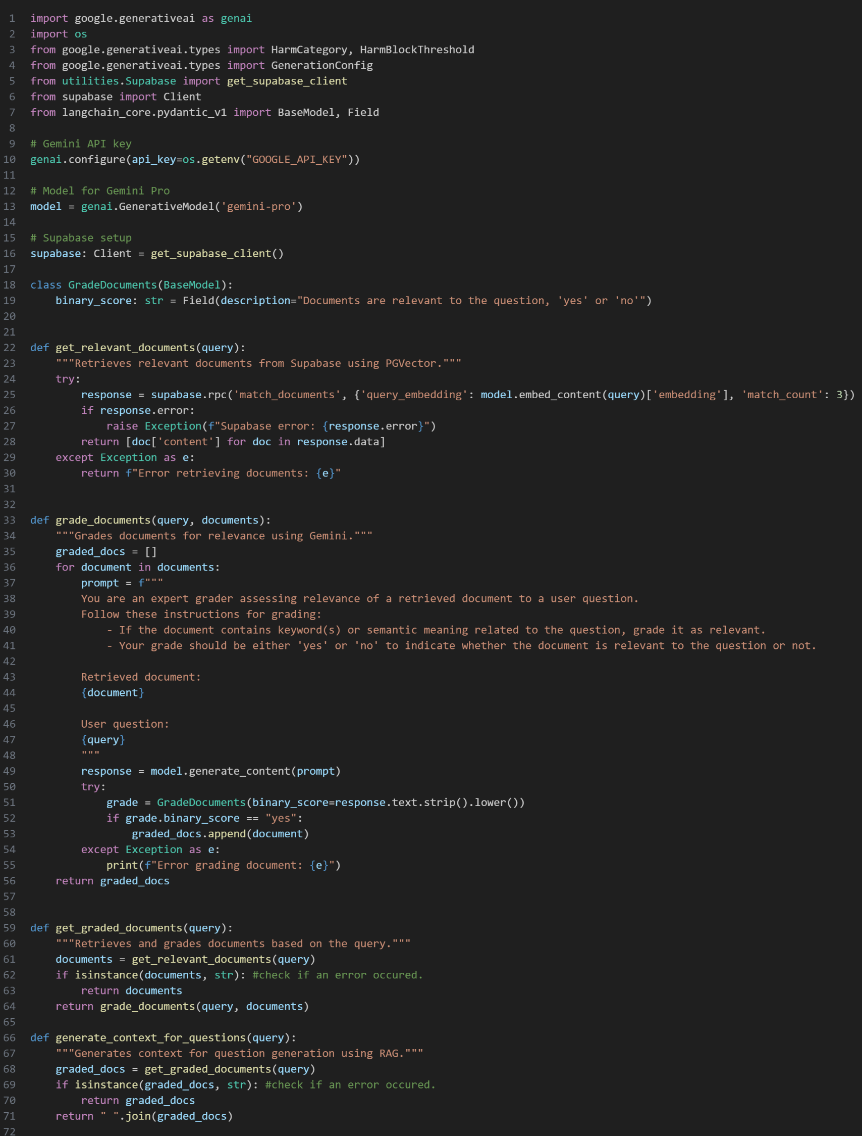
Corrective RAG
IT21118340 | S. A. D. S. Kumarathunga | 24-25J-027
5/26/2025
47

Slide 48
Prompt Optimization Techniques Used
Document Grading and RAG Context Generation:
Role prompting: The grade_documents function uses role prompting by instructing the model, "You are an expert grader assessing relevance of a retrieved document to a user question."
Few-shot prompting: The prompt lists explicit rules, such as "If the document contains keyword(s) or semantic meaning related to the question, grade it as relevant." and "Your grade should be either 'yes' or 'no'." This guides the model's response without providing specific examples.
Contextual Prompting: The prompts include the "Retrieved document" and "User question" to provide the model with the necessary context for grading.
Binary output prompting: The prompt forces the model to choose between two outputs "yes" or "no".
IT21118340 | S. A. D. S. Kumarathunga | 24-25J-027
5/26/2025
48

Slide 49
Agentic Workflows 🤖
Agentic workflows create systems that are proactive and intelligent.
Leverages AI agents, which is a software program that perceives its environment and takes actions to achieve goals. It can interact with users, process information, and perform tasks autonomously.
AI Agents : Use models like Gemini, Deepseek, or Llama to process information and make decisions. Interact with users and systems to perform tasks.
ReAct architecture: Enables agents to "Reason" and "Act," leading to more accurate and contextually relevant responses.
Tool Use/Tool Calling Pattern: Uses modularization, where tasks are assigned to specialized tools
IT21118340 | S. A. D. S. Kumarathunga | 24-25J-027
5/26/2025
49
Notes:
Agentic workflows use AI agents to autonomously interact, process information, and complete tasks.
In our system their 2 workflows that uses the ReAct architecture and Tool Use Pattern.

Slide 50
CRAG-based Multi-Agent Workflow for Question Generation
Automates the creation of essay-style questions and answers based on user interest and skill level.
Built with a team of AI agents that work together:.
Research Agent: Searches the web to gather relevant information about given topic. Use Tool Calling pattern.
Question Generation Agent: Uses information from research agent and from C-RAG to generate a set of questions, with detailed answers, formatted in a structured JSON output.
Corrective Retrieval Augmented Generation (CRAG) Enhancement: To enhance data from Vector DB

Slide 51
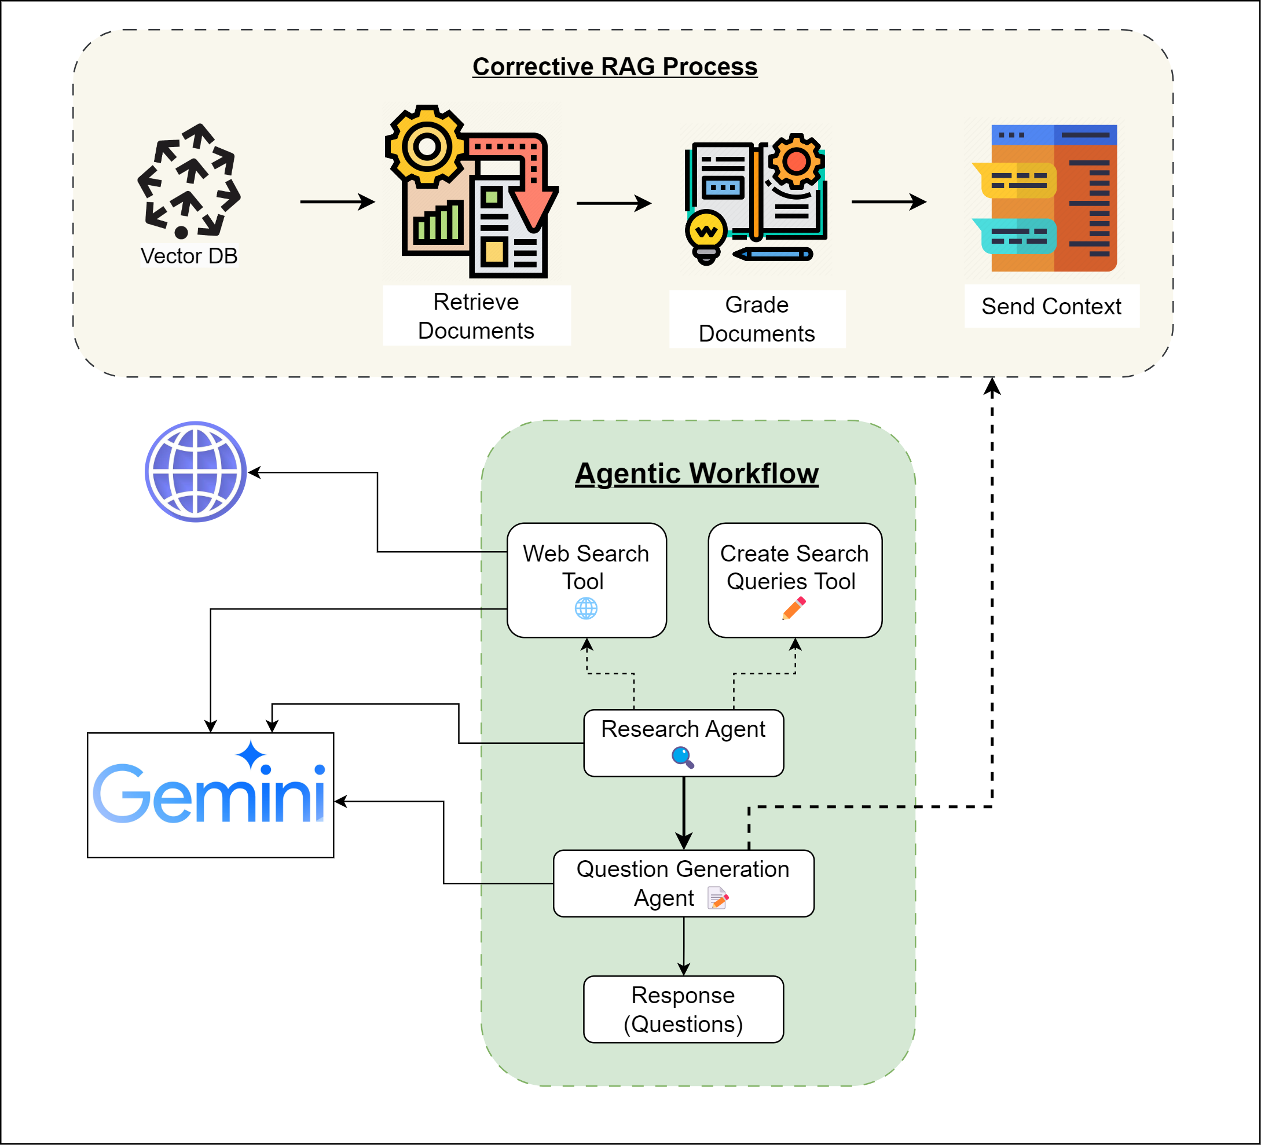

High Level Diagram
Notes:
Research Agent: Searches the web to gather relevant information about given topic
Question Generation Agent: Uses information from research agent and from C-RAG to generate a set of questions, with detailed answers, formatted in a structured JSON output

Slide 52
Prompt Optimization Techniques Used
Question Generation:
Chain of thought reasoning: The prompts explicitly uses "Let's think step by step..." to encourage the model to break down the problem and provide a more reasoned response.
Role-based prompting: The prompt within the question generation agent instructs the model to act in a certain role.
Contextual Prompting: The code utilizes contextual prompting by providing the model with data obtained from web searches.
Zero-shot prompting: Provides the model with research data and instructions on the desired format (JSON), without explicit examples.
Structured Output: The prompts explicitly request the model to return output in a specific JSON format.
IT21118340 | S. A. D. S. Kumarathunga | 24-25J-027
5/26/2025
52

Slide 53
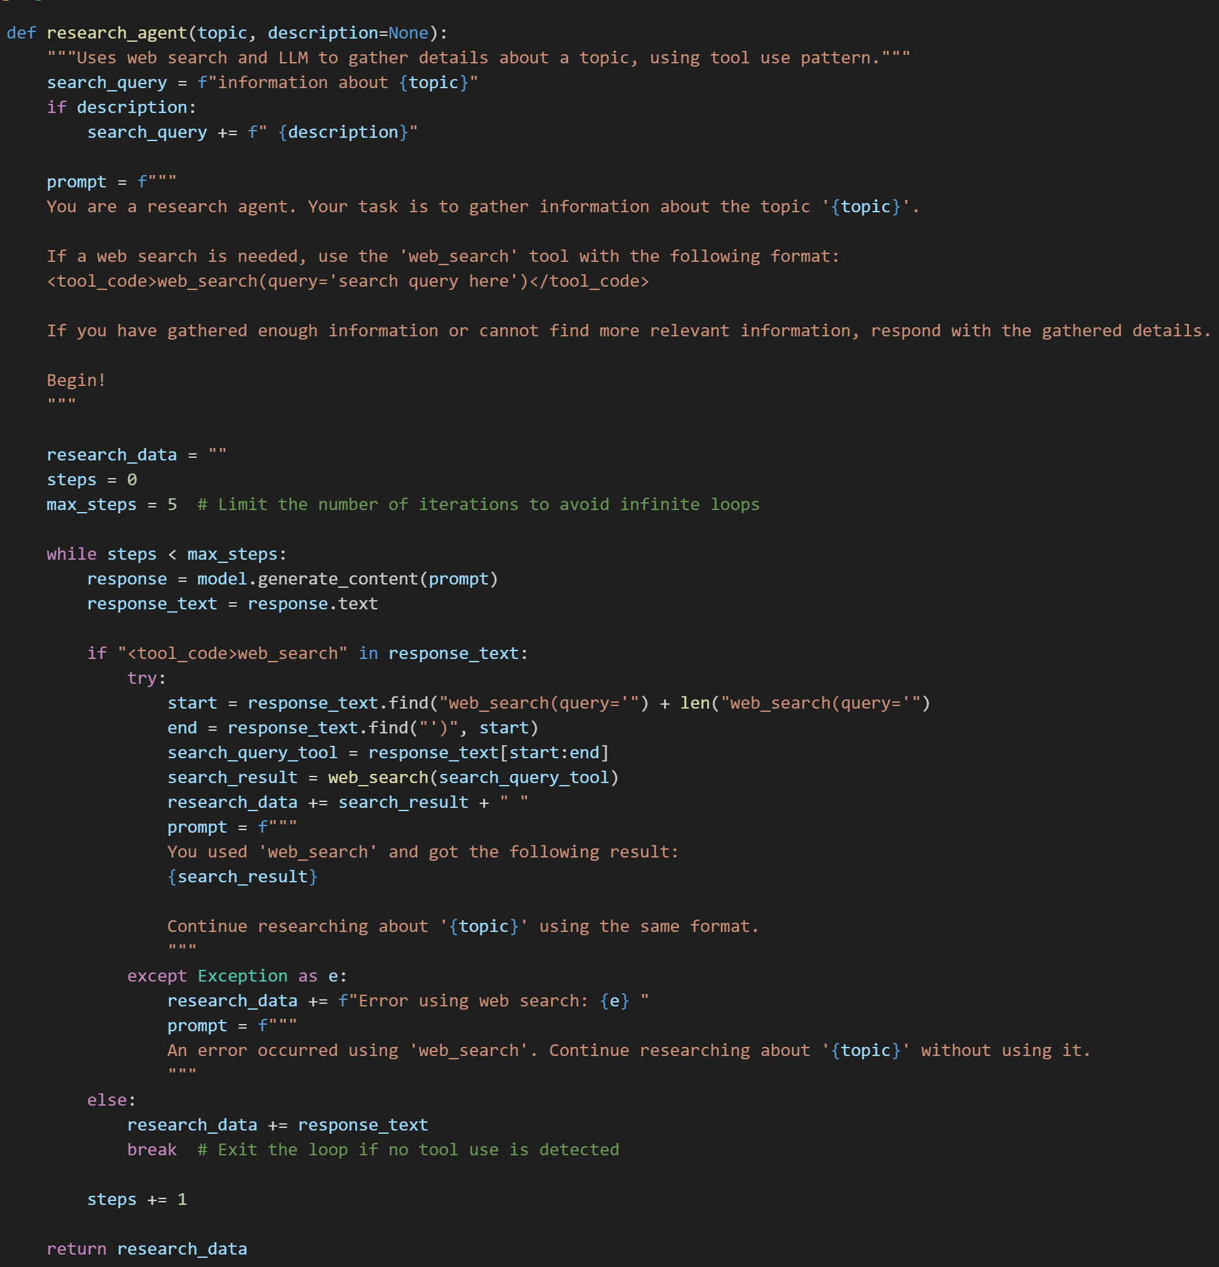
Implementation
Research Agent
IT21118340 | S. A. D. S. Kumarathunga | 24-25J-027
5/26/2025
53
Notes:
Proposed system is designed with key functional goals in mind.
It will dynamically generate content tailored to the user's interests and skill level,
Accurately evaluate user responses without human intervention,
Provide extensive feedback on their answers.
On the non-functional side, focus is on ensuring accuracy, high performance, availability, and user-friendliness

Slide 54
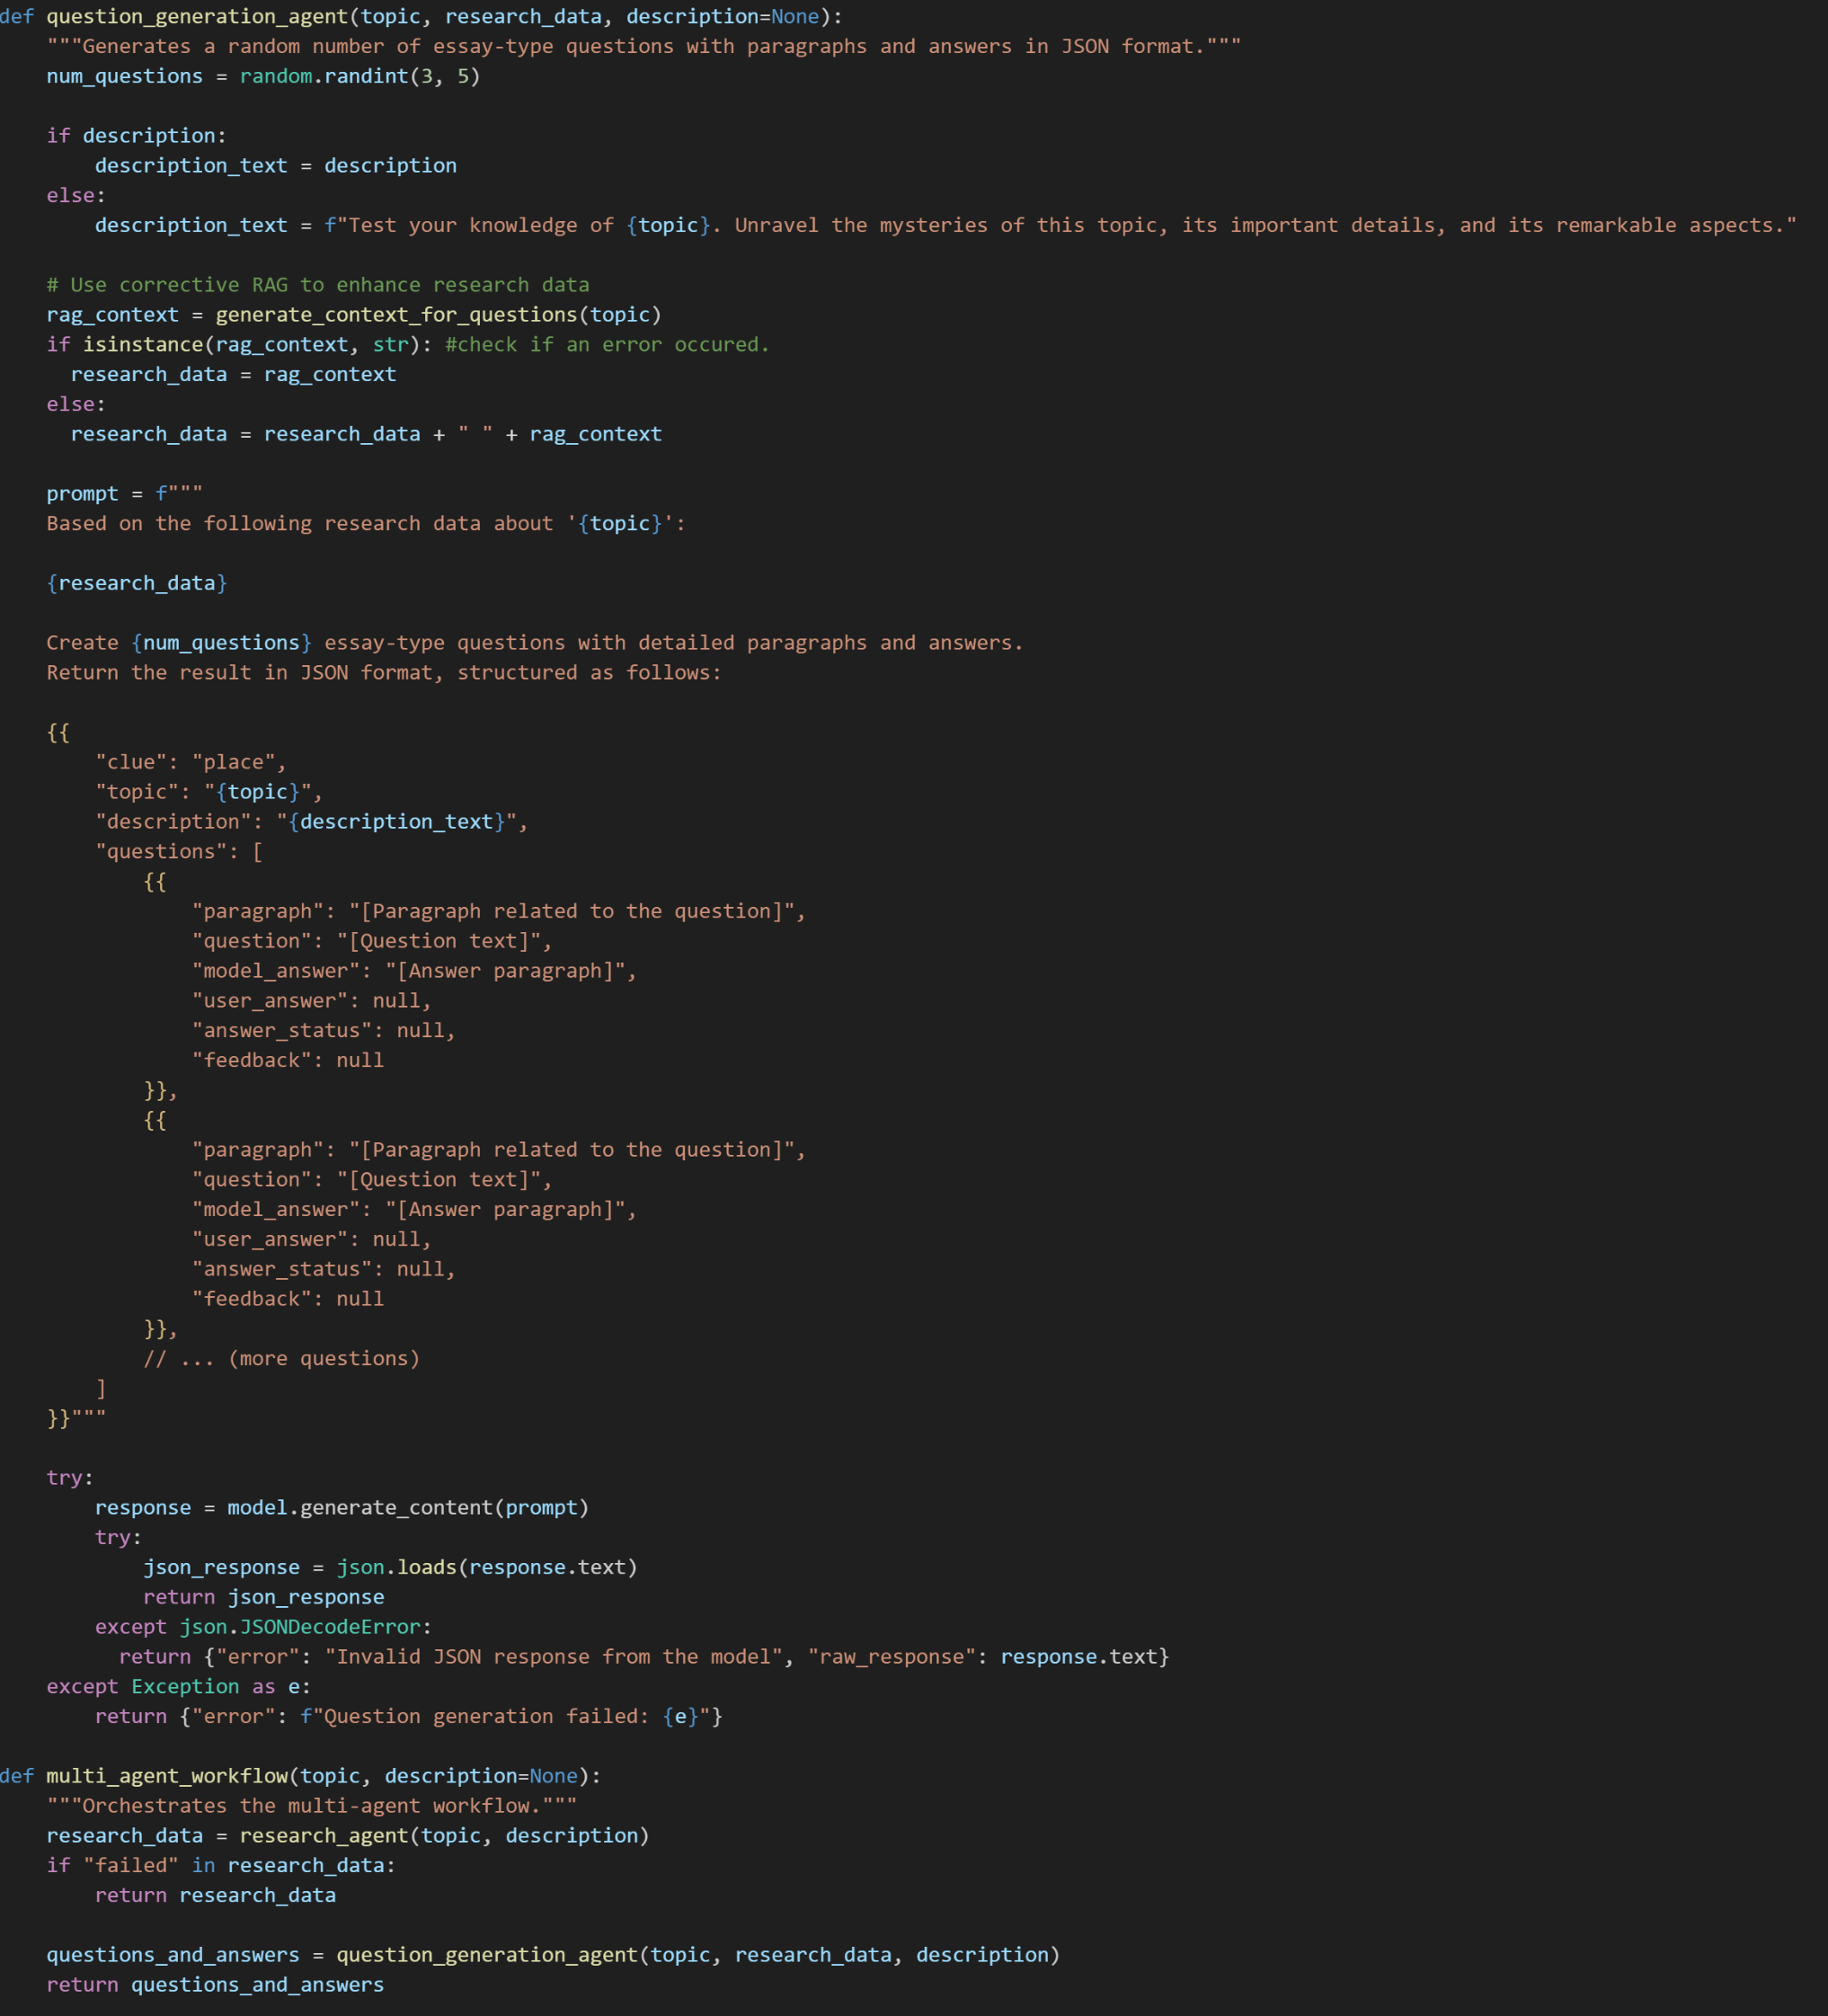
Implementation
Question Generation Agent
IT21118340 | S. A. D. S. Kumarathunga | 24-25J-027
5/26/2025
54
Notes:
Proposed system is designed with key functional goals in mind.
It will dynamically generate content tailored to the user's interests and skill level,
Accurately evaluate user responses without human intervention,
Provide extensive feedback on their answers.
On the non-functional side, focus is on ensuring accuracy, high performance, availability, and user-friendliness

Slide 55
Multi-Model Agentic Workflow With Confidence-Based Fallback And Arbitration Mechanism for Answer Evaluation and Feedback Generation
Employs, multi-modal agentic framework for the evaluation of student responses, integrating confidence-based fallback mechanisms and arbitral synthesis to enhance evaluation robustness and accuracy.
Primary Evaluation Agent (Gemini): The system initiates the evaluation process with the application of Google's Gemini generative model. Gemini performs a contextual analysis of the student's response, generating evaluative feedback and producing a corresponding confidence metric indicative of the model's certainty in its assessment.
Secondary Evaluation using both DeepSeek and Llama (via OpenRouter): In instances where the confidence metric generated by Gemini falls below a predefined threshold, the system triggers a fallback mechanism, invoking secondary evaluation agents. This secondary evaluation is conducted through the OpenRouter API, utilizing DeepSeek and Llama LLMs to provide independent, parallel assessments of the student response.
Arbiter Agent: This agent performs a evaluation of the feedback generated by DeepSeek and Llama in Secondary Evaluation, creates a consolidated and refined response

Slide 56
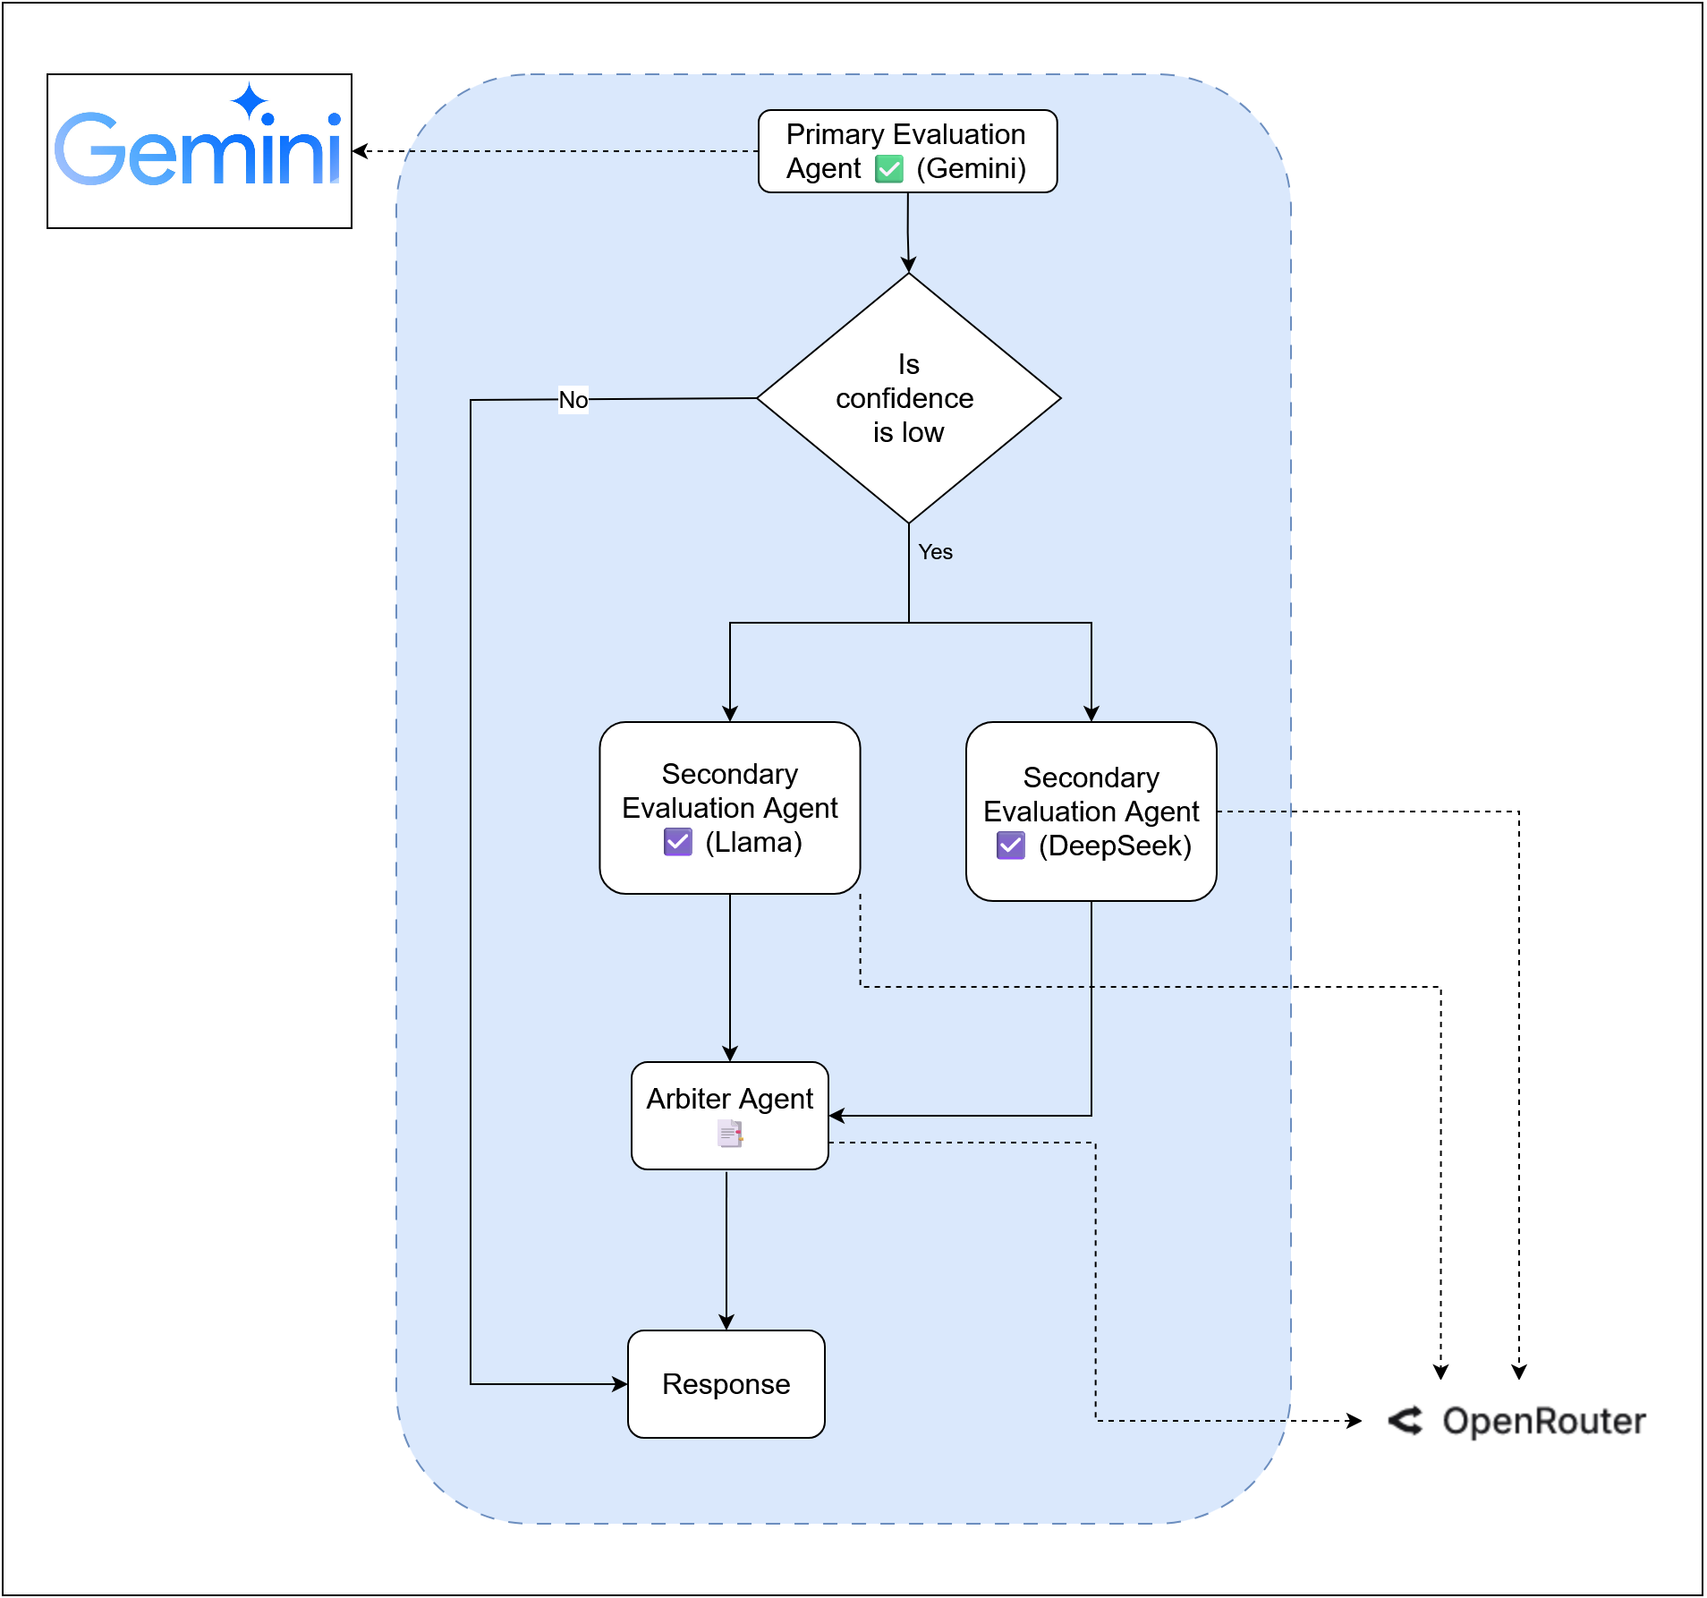
High Level
Diagram

Slide 57
Prompt Optimization Techniques Used
Answer and Feedback Generation:
Chain of thought reasoning: The prompts explicitly uses "Let's think step by step..." to encourage the model to break down the problem and provide a more reasoned response.
Role-based prompting: The prompts explicitly assign a role to the LLM (e.g., "You are a helpful and kind AI teacher"). This guides the model to adopt a specific persona and response style.
Contextual Prompting: The prompts provide the LLM with the necessary context (paragraph, question, user answer) directly within the prompt. .
Zero-shot prompting: Provides the model with research data and instructions on the desired format (JSON), without explicit examples.
Structured Output: The prompts explicitly request the model to return output in a specific JSON format.
IT21118340 | S. A. D. S. Kumarathunga | 24-25J-027
5/26/2025
57
Notes:
Proposed system is designed with key functional goals in mind.
It will dynamically generate content tailored to the user's interests and skill level,
Accurately evaluate user responses without human intervention,
Provide extensive feedback on their answers.
On the non-functional side, focus is on ensuring accuracy, high performance, availability, and user-friendliness

Slide 58
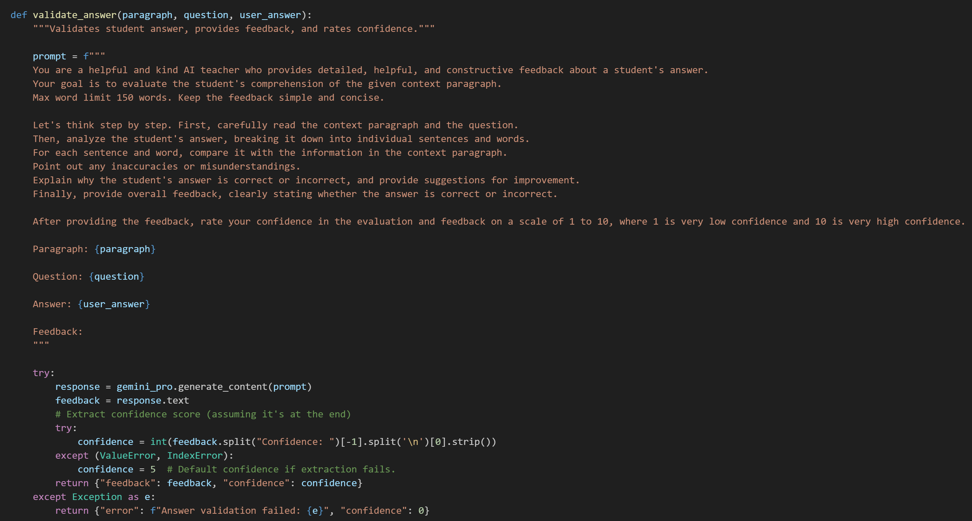
Implementation - Validate Answer
IT21118340 | S. A. D. S. Kumarathunga | 24-25J-027
5/26/2025
58

Slide 59
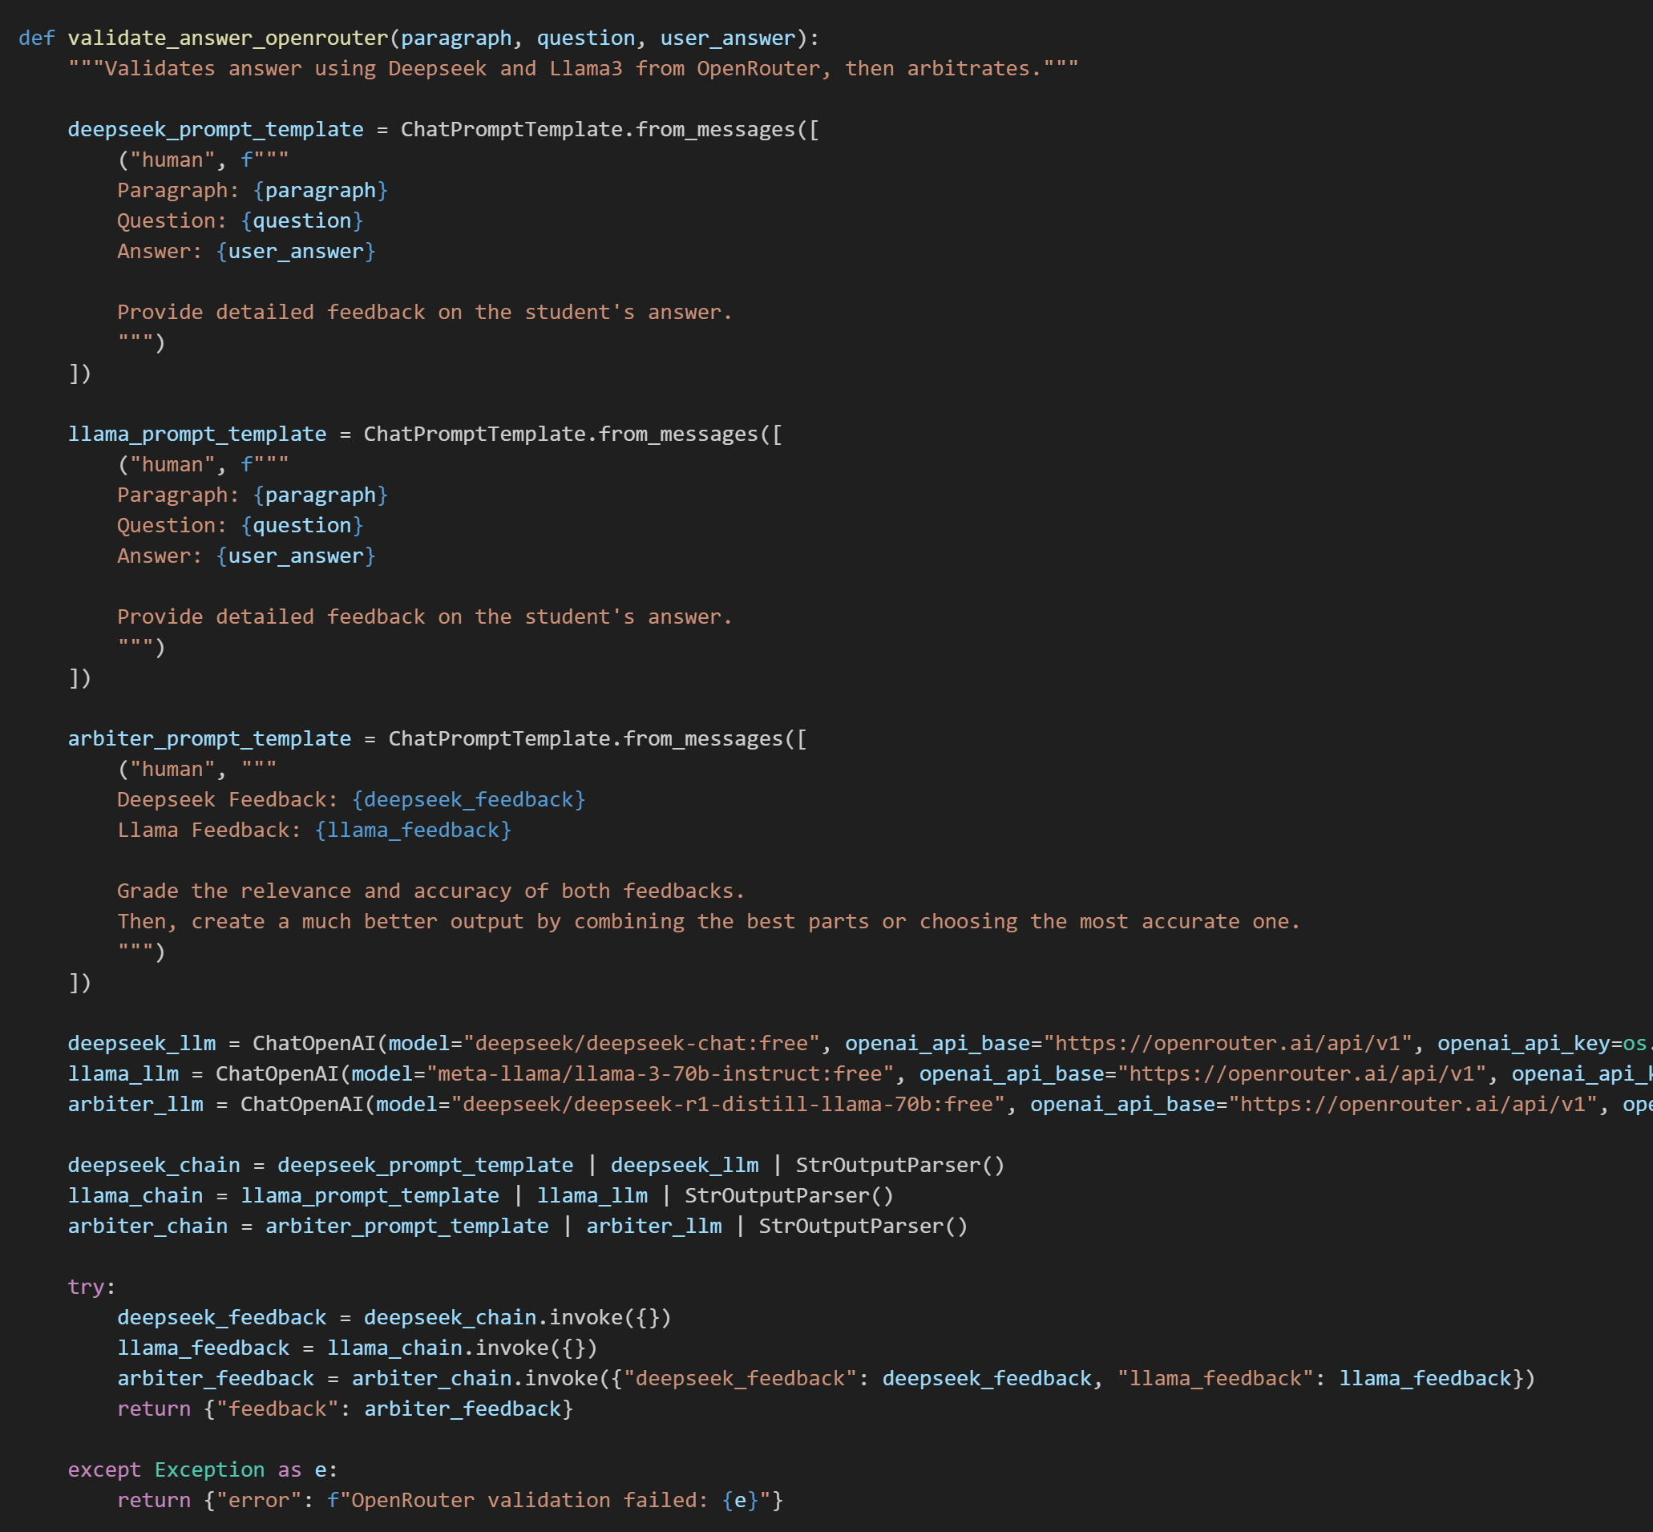
Implementation of Fallback Evaluators and Arbiter
IT21118340 | S. A. D. S. Kumarathunga | 24-25J-027
5/26/2025
59

Slide 60
AI Workflow Evaluation
Objective: Ensured that each workflow is judged not just generically, but based on context-specific performance and task relevance
Evaluation Method: Utilized the LLM-as-a-Judge approach to assess the quality and effectiveness of AI workflows.
Framework Used: Implemented the evaluation using the RAGAS framework for structured and reliable analysis.
Customized Metrics: Developed custom-defined metrics tailored to the unique characteristics and goals of each workflow for more accurate and meaningful evaluation.
IT21118340 | S. A. D. S. Kumarathunga | 24-25J-027
5/26/2025
60
Notes:
I use LLM-as-a-Judge method to evaluate AI Workflows.
I implemented testing using the RAGAS framework and
created custom-defined metrics tailored for each workflow.

Slide 61
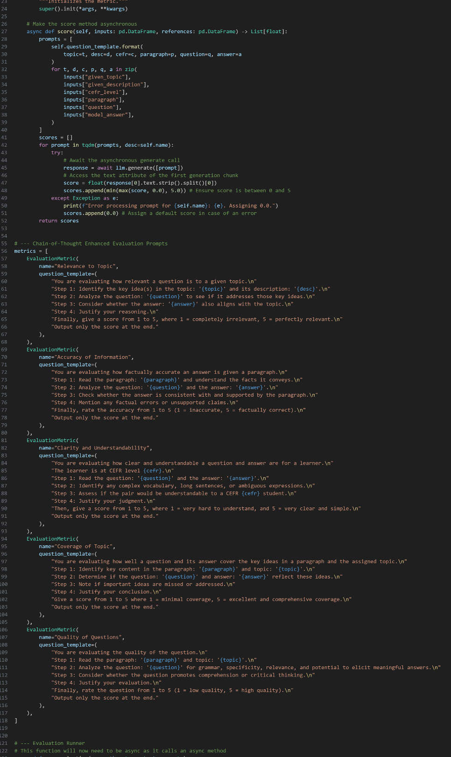
AI Evaluation
CRAG-based Multi-Agent Workflow for
Question Generation
Relevance to Topic
Accuracy of Information
Coverage of Topic
Clarity and Understandability
Quality of Questions
IT21118340 | S. A. D. S. Kumarathunga | 24-25J-027
5/26/2025
61

Slide 62
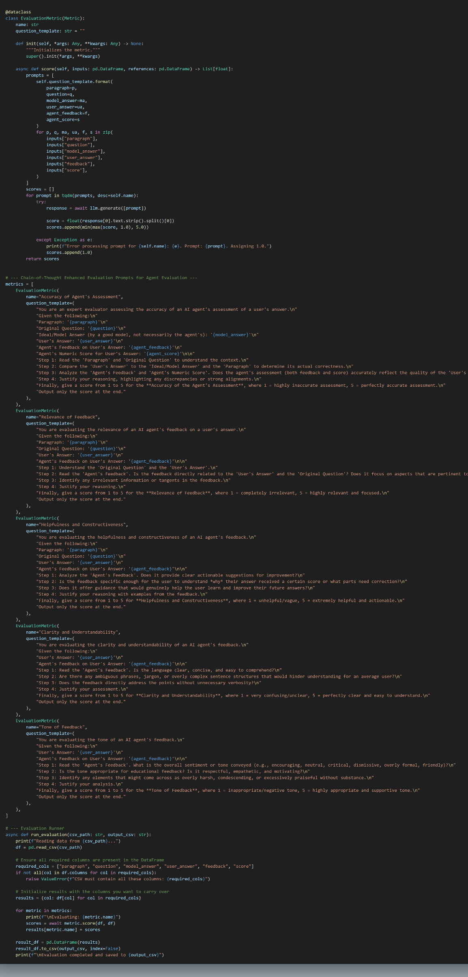
AI Evaluation
Multi-Model Agentic Workflow With Confidence-Based
Fallback And Arbitration Mechanism for Answer Evaluation and Feedback Generation
Accuracy of Assessment
Relevance of Feedback
Helpfulness and Constructiveness
Tone of Feedback
Quality of Questions
IT21118340 | S. A. D. S. Kumarathunga | 24-25J-027
5/26/2025
62

Slide 63
Software Specification Requirements
Functional:
The system should be able to dynamically generate content given on user's interest.
The system should be able to accurately evaluate user answer without human intervention
The system should be able to give extensive feedback about user's answer
Non Functional: Accuracy, Performance, Availability, Usability
IT21118340 | S. A. D. S. Kumarathunga | 24-25J-027
5/26/2025
63
Notes:
Proposed system is designed with key functional goals in mind.
It will dynamically generate content tailored to the user's interests and skill level,
Accurately evaluate user responses without human intervention,
Provide extensive feedback on their answers.
On the non-functional side, focus is on ensuring accuracy, high performance, availability, and user-friendliness

Slide 64
Other Requirements
Software:
Languages: JavaScript & Python
Web Frameworks: React & Fast API
Database: Supabase & Pinecone
AI/ML: Gemini, Open Router,
LLM: LangChain, Llama-Index
CI/CD – GitHub, Docker, Kubernetes
Personal:
Expertise in
Web frameworks
LLM related tools
Database Design
System Design & Deployment
IT21118340 | S. A. D. S. Kumarathunga | 24-25J-027
5/26/2025
64
Notes:
This is a list software I intend use to develop our system.
On the personal requirements, Expertise in web frameworks, LLM-related tools, database design, and system design and deployment are required.

Slide 65
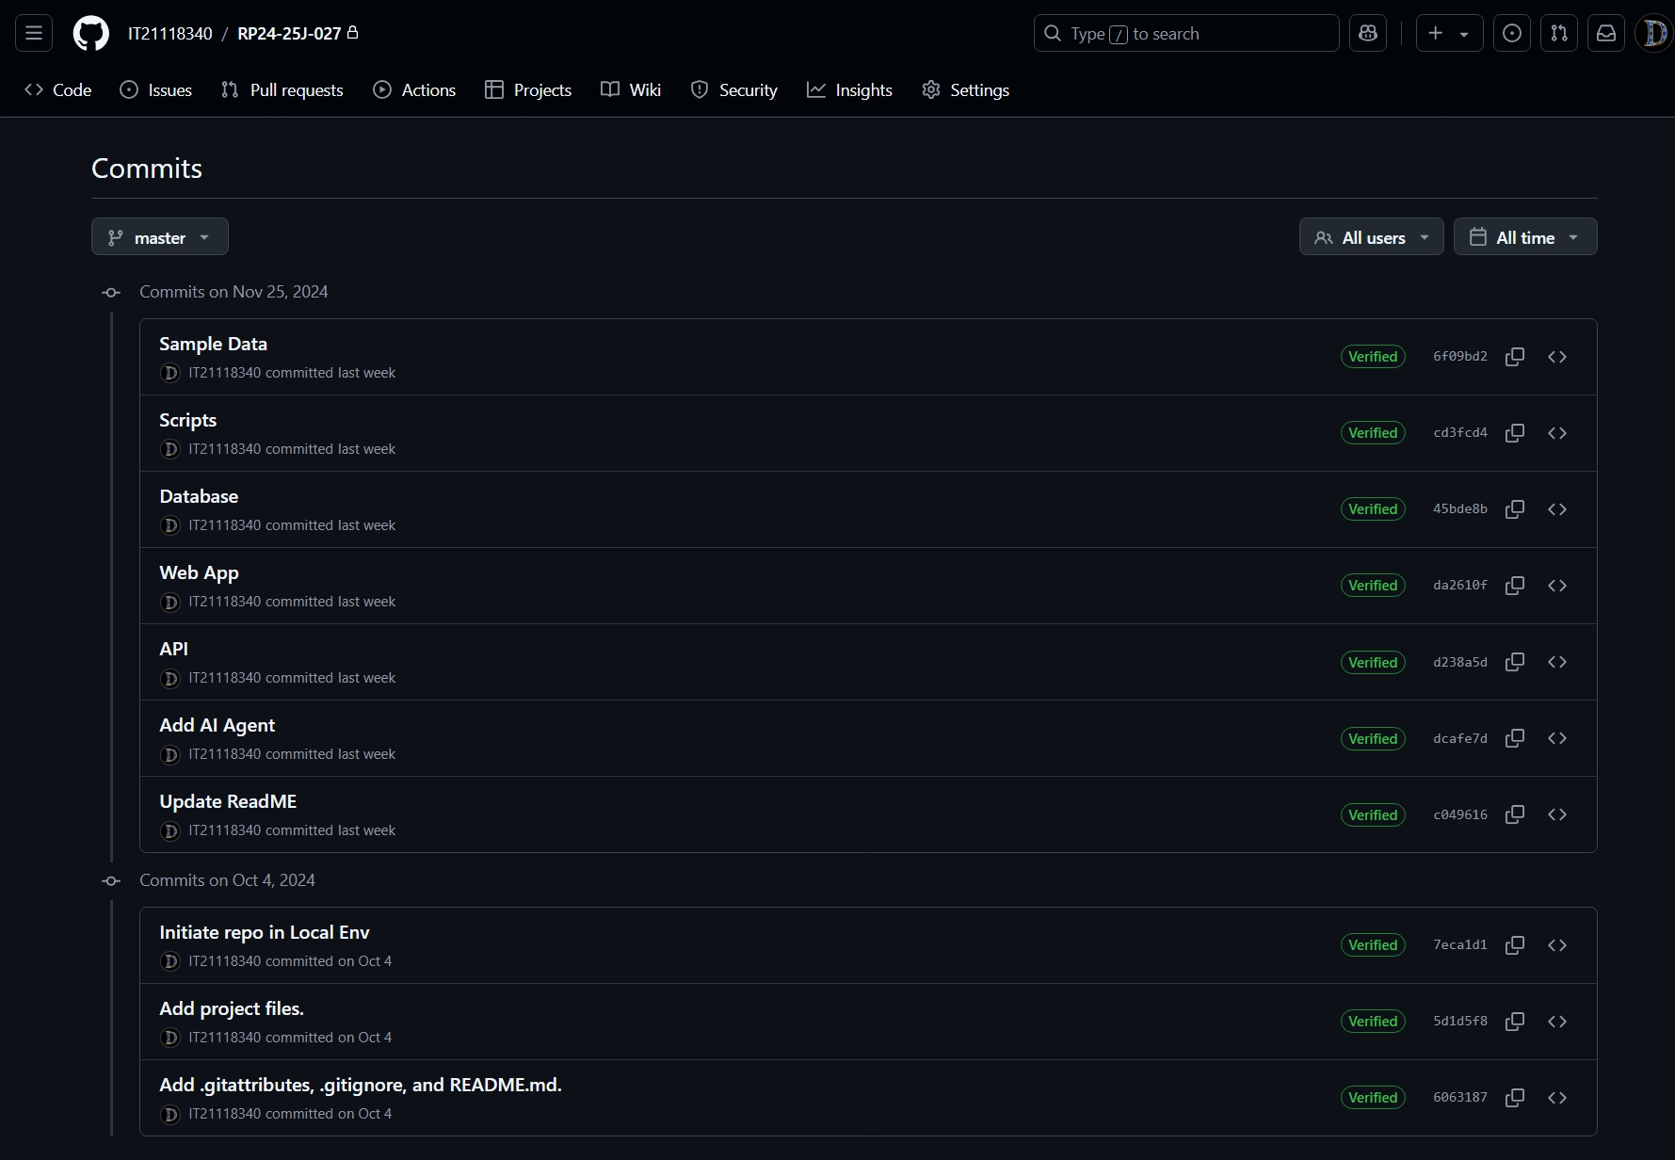
Github Commits
IT21118340 | S. A. D. S. Kumarathunga | 24-25J-027
5/26/2025
65
Notes:
This is a list software I intend use to develop our system.
On the personal requirements, Expertise in web frameworks, LLM-related tools, database design, and system design and deployment are required.

Slide 66
References
[1] K. Moholkar, M. Chaturvedi, A. Jain, A. Parkhe and K. Singh, "Machine Learning Techniques for Descriptive Answer Evaluation: A Comprehensive Survey," 2024 International Conference on Inventive Computation Technologies (ICICT), Lalitpur, Nepal, 2024, pp. 1412-1419, doi: 10.1109/ICICT60155.2024.10544714.
[2] P. Mirabal, M. Castillo-Sanhueza, R. Curín-Zarate and O. O. Calzadilla-Pérez, "Use of Language Models based on Deep Learning to improve reading comprehension," 2023 42nd IEEE International Conference of the Chilean Computer Science Society (SCCC), Concepcion, Chile, 2023, pp. 1-6, doi: 10.1109/SCCC59417.2023.10315757.
[3] Laban, P., Wu, C., Murakhovs'ka, L., Liu, W., & Xiong, C. (2022). Quiz Design Task: Helping Teachers Create Quizzes with Automated Question Generation. NAACL-HLT.
[4] Xia, W., Mao, S., & Zheng, C. (2024). Empirical Study of Large Language Models as Automated Essay Scoring Tools in English Composition Taking TOEFL Independent Writing Task for Example. ArXiv, abs/2401.03401.
[5] Hussein, M.A., Hassan, H.A., & Nassef, M. (2019). Automated language essay scoring systems: a literature review. PeerJ Computer Science, 5.
66
5/26/2025
IT21118340 | S. A. D. S. Kumarathunga | 24-25J-027
5/26/2025
66
Notes:
I would like invite Asanka to present his section.

Slide 67
Phoneme-Level Speech Error Detection Module
IT21182396 – A. P. Ranaweera
IT21182396 | A. P. Ranaweera | 24-25J-027
5/26/2025
67

Slide 68
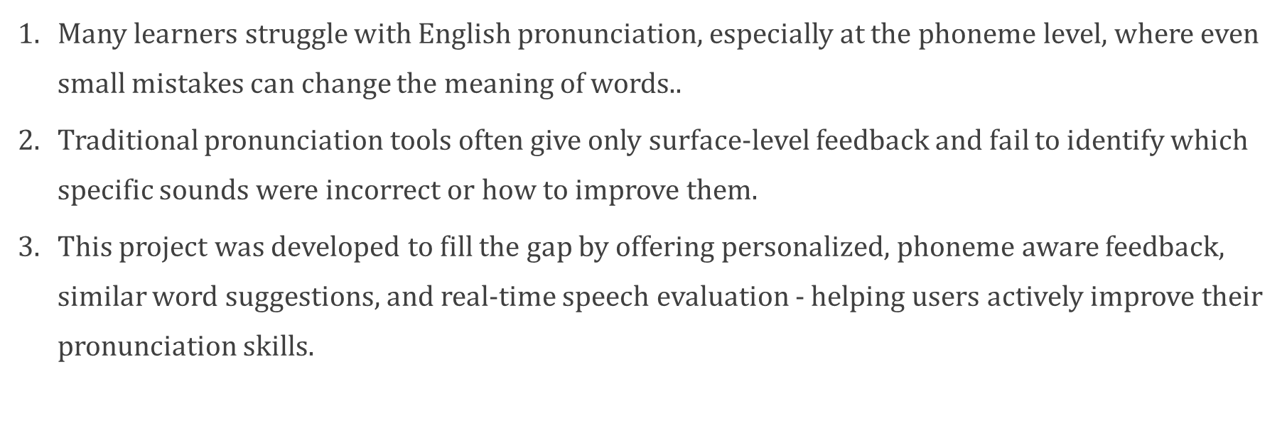
Background
IT21182396 | A. P. Ranaweera | 24-25J-027
5/26/2025
68
Notes:
Identify student current performance level and develop a personalized learing path base on it . So that after identify current level… system predict which level is the appropriate quiz for next
Based on what the user entered in the quiz ,,,, at that time ML algorithm analyze the data accurately… assess each user s proficiency…. And determine the appropriate level of quiz to present to next.

Slide 69
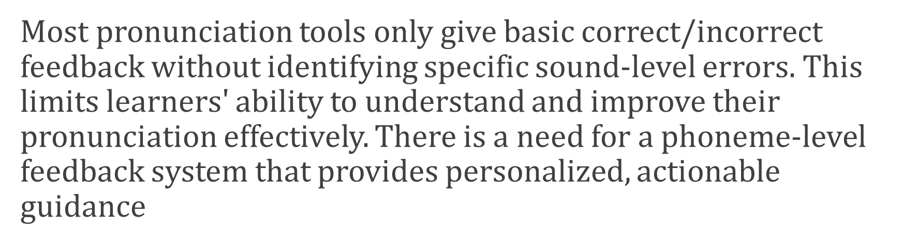
Research Problem?
IT21182396 | A. P. Ranaweera | 24-25J-027
5/26/2025
69
Notes:
That kind of english reading and comprehension improving platfor............
We have compared the existing platgorm and.... ifentifyy what feature should be included to our ptoposed one.... included the additional things of our proposed applicationWe have included personalized learning path feature in our proposed systemPlan to measure student performance in several ways

Slide 70
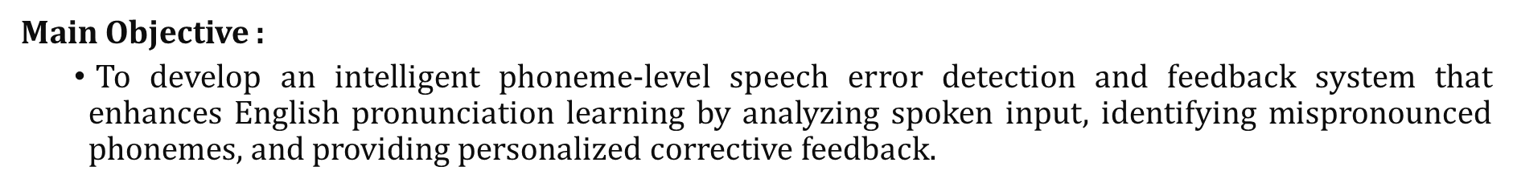
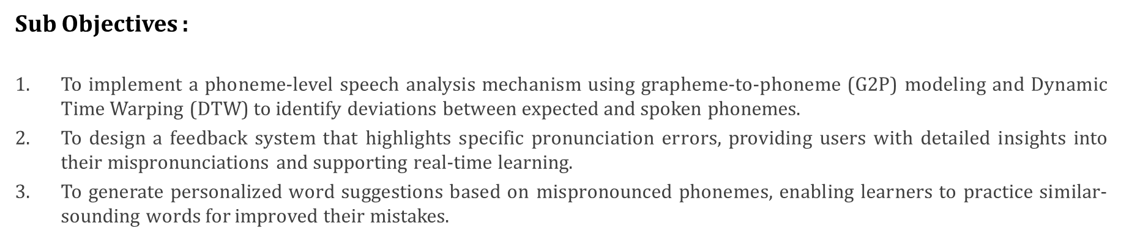
Research Objectives
IT21182396 | A. P. Ranaweera | 24-25J-027
5/26/2025
70
Notes:
There are anlyze the time pet for session and analyzing the time spent on one question … according to that odentifying student level
For that compare with the time spent by him…time it usually takes to complete a question of that level
Comparison of the number of qus student get wrong in that level session
Compare his mistakes wrong patterns
The difficulty level of the question can be enterd acodrindgto how the student felt at the end of the question
anlyze the behavior in this earkier kevel
Use this kind of parameters buy analize accordingly he ca gather numb er of point acrding to it determine what kind of level would be the

Slide 71
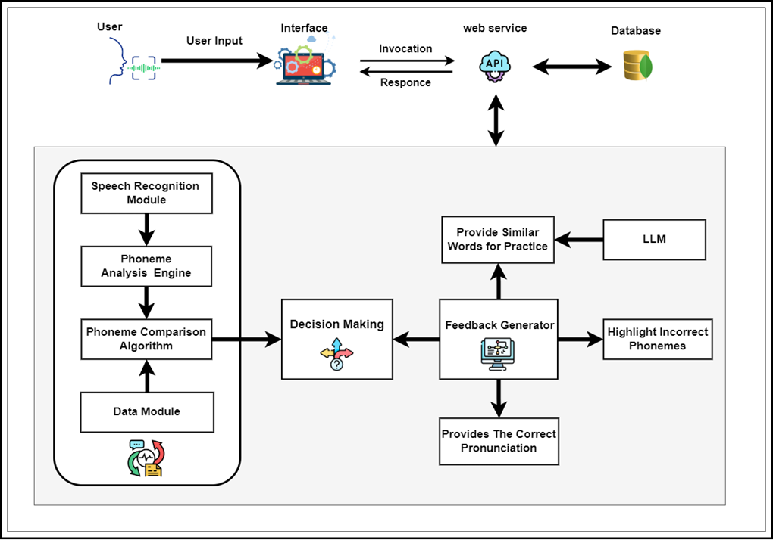
SystemDesign
IT21182396 | A. P. Ranaweera | 24-25J-027
5/26/2025
71
Notes:
There are anlyze the time pet for session and analyzing the time spent on one question … according to that odentifying student level
For that compare with the time spent by him…time it usually takes to complete a question of that level
Comparison of the number of qus student get wrong in that level session
Compare his mistakes wrong patterns
The difficulty level of the question can be enterd acodrindgto how the student felt at the end of the question
anlyze the behavior in this earkier kevel
We are plane to train data set that include average time taken for each level of questions
After we gather user inputs analize varies type of models .. So that how many presentage effect to the output … from this type of parameter .. According to that finally cal how many point gather from current level.
Use this kind of parameters buy analize accordingly he ca gather numb er of point acrding to it determine what kind of level would be the next

Slide 72
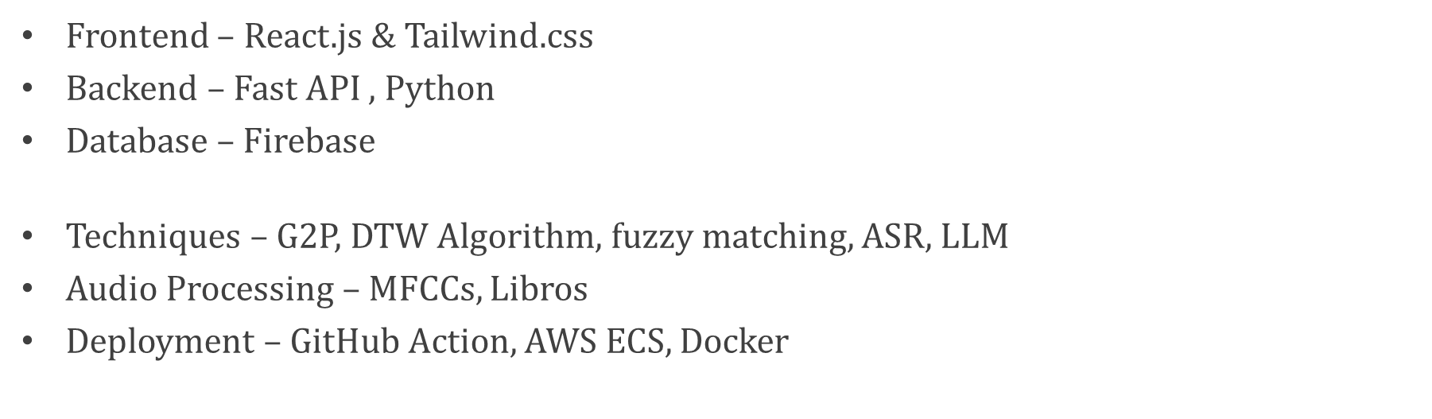


Tools & Technologies
IT21182396 | A. P. Ranaweera | 24-25J-027
5/26/2025
72

Slide 73
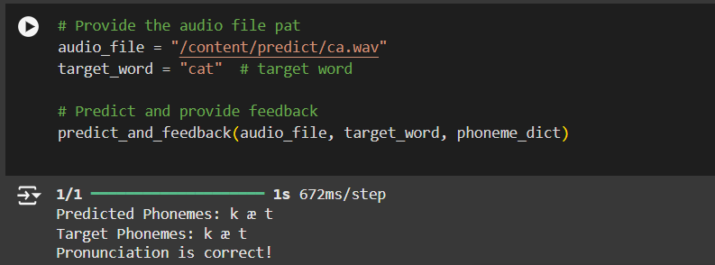
Design the Model
Continue training the model for enhanced accuracy.
Expand and improve the dataset.
Integrate accurate pre-trained models for phoneme error detection.
Prepare the data for the RNN model.
Design the model architecture using an RNN (LSTM or GRU layers).
Train the model on preprocessed audio features (MFCCs) and phoneme mappings.
Evaluate the model's performance.
Prepare the data for the RNN model.
Design the model architecture using an RNN (RNN architecture with LSTM).
Train the model on preprocessed audio features (MFCCs) and phoneme mappings.
IT21182396 | A. P. Ranaweera | 24-25J-027
5/26/2025
73
Notes:
Slide eke ewa epaa…
Slide topic:::::
--implements a phoneme classification system using a Recurrent Neural Network (RNN) with Long Short-Term Memory (LSTM) layers
--It leverages the preprocessed MFCC features from the earlier stages and trains a model to predict phonemes based on these features.
That RNN with LSTMs::::: LSTMs handle sequential data like MFCC features effectively,Maps MFCC features to phoneme categories.
After Trains the Model,,,,,,,
Runs training for 20 epochs with a batch size of 32.

Slide 74
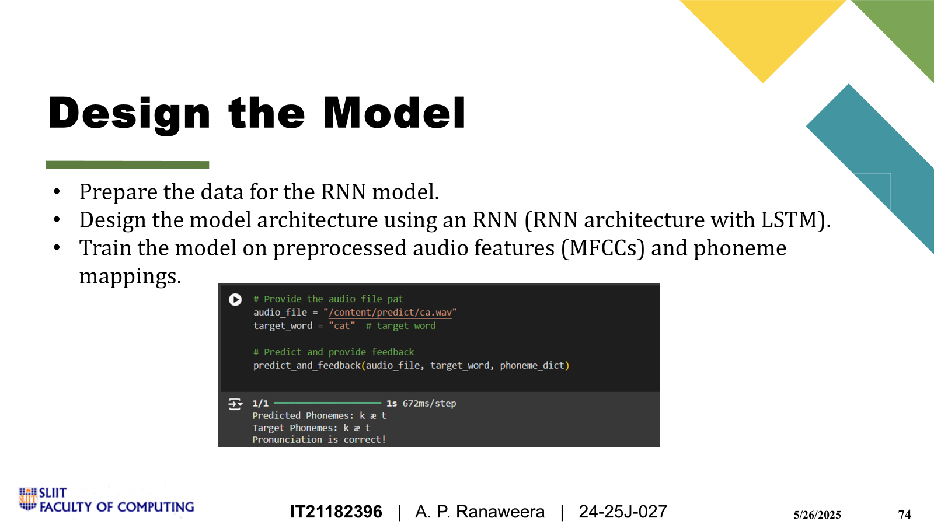
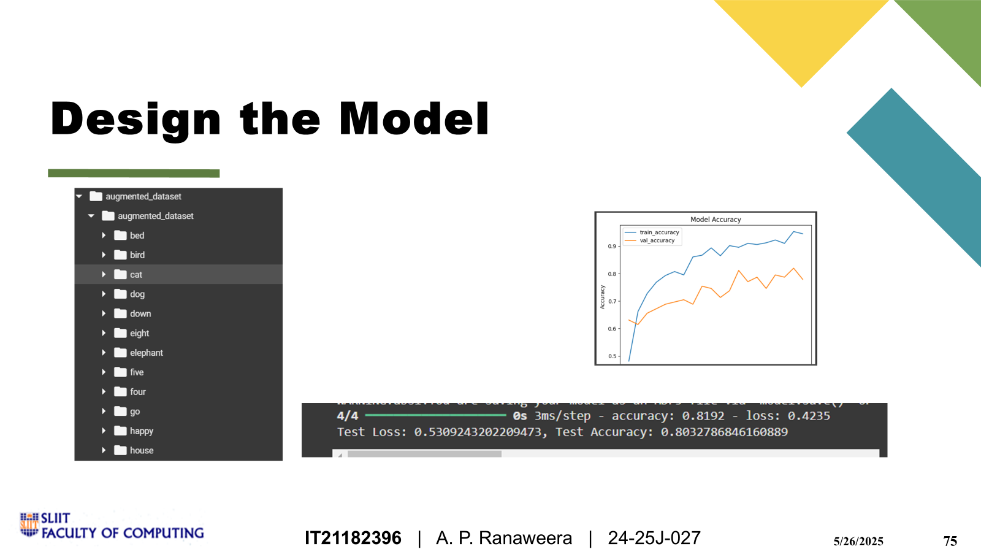
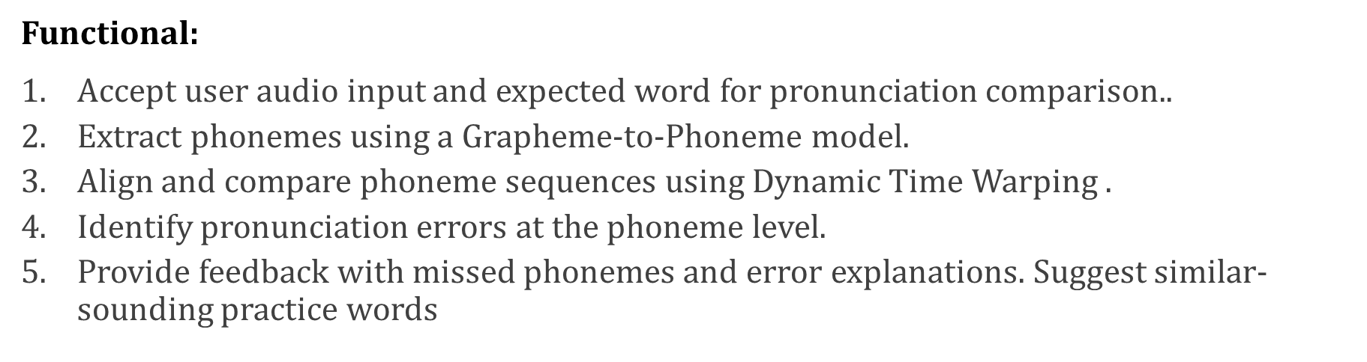
Software Specification Requirements
IT21182396 | A. P. Ranaweera | 24-25J-027
5/26/2025
74

Slide 75
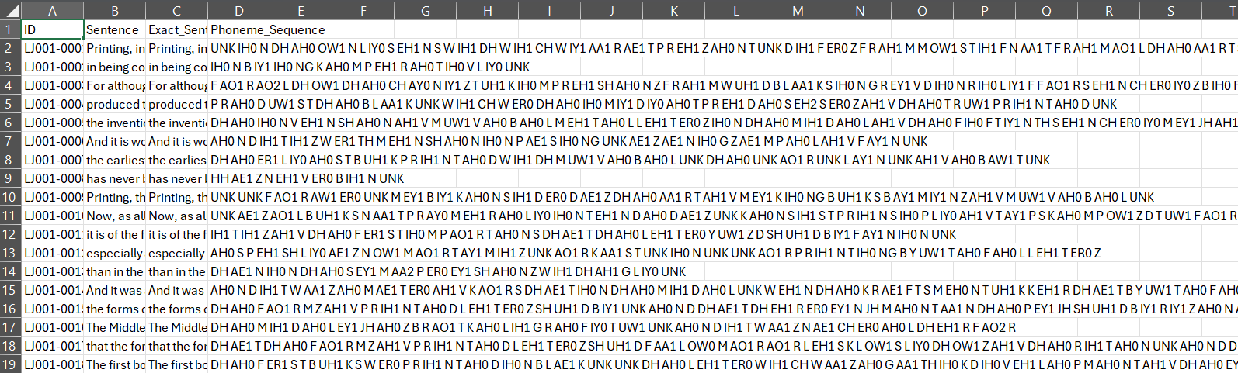
Dataset
Continue training the model for enhanced accuracy.
Expand and improve the dataset.
Integrate accurate pre-trained models for phoneme error detection.
Prepare the data for the RNN model.
Design the model architecture using an RNN (LSTM or GRU layers).
Train the model on preprocessed audio features (MFCCs) and phoneme mappings.
Evaluate the model's performance.
IT21182396 | A. P. Ranaweera | 24-25J-027
5/26/2025
75
Notes:
This gives the phoneme of certain words… In this case , I think that the size of dataset is not enough.. Some times errors are highited in mispronounciations. It should be correct in the future..

Slide 76
Approaches
Continue training the model for enhanced accuracy.
Expand and improve the dataset.
Integrate accurate pre-trained models for phoneme error detection.
ASR
G2P
Dynamic Time Warping (DTW)T
Time shift handling
Variable spead tolerance
Shape base similarities
Fuzzy Matching
IT21182396 | A. P. Ranaweera | 24-25J-027
5/26/2025
76
Notes:
Audio Recordings : We used collection of audio recordings. That consist with Pronunciations of words by native and non-native speakers.
Metadata.csv file :
* automate the creation of a metadata file for audio datasets. Metadata is essential for organizing datasets
* It includes file names, paths, phonemes, and transcriptions
* Links words to their phonetic representations using the phoneme dictionary

Slide 77
Risk Mitigation
Risk | Trigger | Owner | Response | Resource Required
High operational costs | Excessive cloud computing and infrastructure expenses | Team | Implement cost-saving strategies such as using smaller models | Product Backlog
Illness or sudden absence of the project team member(s) | Illness / Other personal emergencies | Leader | Inform to the supervisor and co-supervisor. Development team divides the functions with equal scope. | Project Schedule Plan / Gantt Chart
Changes requested by evaluation panel | Not satisfied with The product / presentation / outcome | Team | Do the necessary changes immediately. Update the changes in all required documents. Update the changes to the required persons. | Project Schedule Plan/Gantt Chart, Product Backlog, Meeting Log
Supervisor/s Request changes | Not satisfied with The Product / presentation / outcome | Team
Panel / Supervisor/s are not at the scheduled meetings | Illness / Other personal emergencies | Leader | Inform it to the required persons immediately. Reschedule the meeting/ do necessary alternatives | Meeting log, Emails
77
5/26/2025
5/26/2025
77

Slide 78
Supportive Information Commercialization
Target Audience: High school students, English language learners, Educators
Business Model: Software as a Service
Free tier: Ad Supported ( Advertisements from education institutions)
Premium version: Subscription based
Marketing:
Establish partnerships with educational institutions to pilot and scale the product
Explore collaborations with government agencies and non-profit organizations focused on literacy and education
78
5/26/2025
5/26/2025
78

Slide 79
Supportive Information Budget
Resource​​ | Cost Per Month​ | Cost (LKR)​
Direct Costs​ | ​ | ​
Deployment cost​ | $28​ | LKR 15000.00
Domain​ | $15​ | LKR 5000.00
Indirect Costs​ | ​ | ​
Wi-Fi / mobile data​ | $​5 | LKR 3000.00​
79
5/26/2025
5/26/2025
79

Slide 80
Thank You
Any questions??
80
5/26/2025
5/26/2025
80

